Slide 1
Ethan Frome
By Edith Wharton

Slide 2
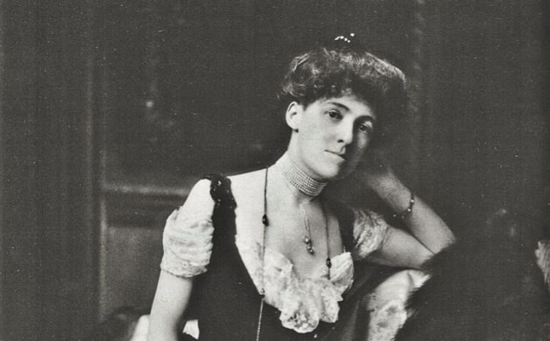
About Edith Wharton
Edith Newbold Jones
1862 - 1937
Best american author in writing novels about the upper-class society
A naturally gifted storyteller, she wrote novels and short fictions notable for their vividness, satire, irony, and wit
Edith married Edward Wharton, an older man whom the Jones family found to be of suitably lofty social rank. She divorced him in 1913, although she never renounced his family name
First woman who won Pulitzer price for Literature

Slide 3
How enviroment influenced the novellist
Puritan society
“pure” = without sin, puritan values are: following the Bible, being modest, not showing off, having a moderal dressing style. The heart of puritan culture is family (which is a traditional family), where the man is considered the head of the household.
Her marriage
her falied marriage influenced her writings and her vision of relationships, that are not long-lasting
The relationship with her mother
she has always criticized her works

Slide 4
Themes of the novel
Sickness Ethan spends his whole life in taking care of ill people
Criticize puritan society people want to progress in the social class
Reputation it is a value that puritan people cannot renounce and it follows, Ethan tries to change his life only in abstract
Love The novelist wants to make the reader understand the real meaning of love, that in the novel is seen like the fear of being alone
Weakness of human being

Slide 5
Use of language
The language is very detailed :
for giving realism to the novel
for making the reader better understand Ethan’s feelings (using metaphors of weather conditions)
through the descriptions the reader is able to identify himself with the characters

Slide 6
Narrators features
There are two kind of narrators
First person narrator
he is present in the Prologue and the Epilogue
he is omniscent
His role is to introduce the story and tell the reader how is organized the short novel (narrative tecnique)
Third person narrator
he is present in the central part of the novel
he is not omniscent
He tells the story in Ethan’s point of view

Slide 7
Narrative tecnique
Prologue and epilogue
FUNCTIONS:
The stories can be told in different ways
Body of the novel
FUNCTIONS:
Make the reader understand about Ethan’s feelings, who is the victim of the circumstances
Discuss the Puritanism’s values (expressed through metaphors)

Slide 8
Theme of Love
Love is confused with the fear of lonlyness
Love between Mattie and Ethan :
he feels in love with her only because of her innocence
She is the only thing that keeps back him from his cruel reality
It is an impossible love story: they will never allowed by Puritan values to love each other
Love between Zenobia and Ethan :
it isn’t a true love
fear of lonlyness
marriage based on puritan values

Slide 9
The victim
We may consider Ethan and Zeena the victims of the novel
Ethan
He is a weak person. He will never go against social values so he will never realize himself.
Zeena
We don’t know so much about her. We know she is the wife of Ethan Frome and she is a nurse. We don’t know about her family: she married Ethan only for not being alone. She is a victim, she feels lonley, ignored and the only way she gets reader attention is for his profession.

