Slide 1
Edith wharton

Slide 2
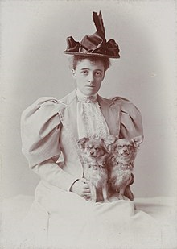
1.Who was edith wharton?
Edith Wharton was an American novelist, short story writer and playwright. She was the first woman to win the Pulitzer Prize for Literature in 1921. She was born in New York, 24 January 1862 .

Slide 3
2.social enviroment
A descendant of an old and wealthy New York family, Newbold-Jones, Edith Newbold Jones was born in New York , during the Civil War;
From 1866 to 1872, the Jones family visited France, Italy, Germany, and Spain. During her travels, the young Edith became fluent in French, German, and Italian.
After the family returned to the United States in 1872 .While in Europe, she was educated by tutors and governesses. She rejected the standards of fashion and etiquette that were expected of young girls at the time. She considered these fashions superficial and oppressive
Edith wanted more education than she received, so she read from her father's library and from the libraries of her father's friends
She did not have any public school, studying privately and concentrating on the great authors of the past

Slide 4
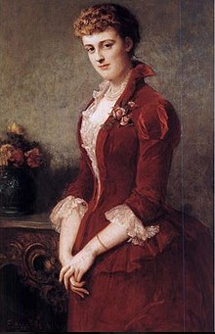
3.influences
Most of its copious production themes the problem of the relationship between the individual and its social group. She lived in rigidly conservative environment, such as that of the so-called "aristocracy of money"
She was influenced by Henry James(a friend and confidant who encouraged her to continue her literary career) and Jane Austen
She was born in a Puritan family, where an individual needs to progress in social state

Slide 5
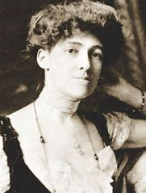
4.Themes
His works show a profound knowledge of the human soul
Complex female characters, victims of society. Women are subjected to a wrong education and forced to depend economically on men

Slide 6
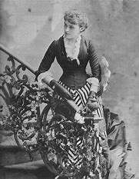
5.description
She wrote fictions. The stories aren’t true, but the reader has to pretend that the story is true. Edith Wharton usually inserts many descriptions so that the story appears credible to the reader.
She descrived Ethan Frome like the most striking figure in the country. She insisted in his physical conditions. Even the setting is symbolic, it describes it as winter, cold, hard. The prologue takes place at noon, when the temperature is higher and allows people to get out

Slide 7
6.narrator
The narrator in Ethan Frome changes during the novel. In the Prologue is in first person. He is an unnamed narrator that underlines that what is going to tell us is from different people and so from different point of view. He does a reconstruction of the events and so he isn’t responsible. The function of the prologue is allert the reader about narrative tecnique.
In chapters the narrator becomes in third person and in the epilogue returns in first person.

Slide 8
7.example
Ethan Frome
I had the story, bit by bit, from various people, and, as generally happens in such cases, each time it was a different story.
If you know Starkfield, Massachusetts, you know the post-office. If you know the post-office you must have seen Ethan Frome drive up to it, drop the reins on his hollow-backed bay and drag himself across the brick pavement to the white colonnade; and you must have asked who he was.
It was there that, several years ago, I saw him for the first time; and the sight pulled me up sharp. Even then he was the most striking figure in Starkfield, though he was but the ruin of a man. It was not so much his great height that marked him, for the “natives” were easily singled out by their lank longitude from the stockier foreign breed: it was the careless powerful look he had, in spite of a lameness checking each step like the jerk of a chain. There was something bleak and unapproachable in his face, and he was so stiffened and grizzled that I took him for an old man and was surprised to hear that he was not more than fifty-two. I had this from Harmon Gow, who had driven the stage from Bettsbridge to Starkfield in pre-trolley days and knew the chronicle of all the families on his line.
Avevo sentito la storia, a frammenti, da varie persone, e, come spesso accade in casi simili, ogni volta era una storia diversa. Se conoscete Starkfield, Massachusetts, conoscete anche l'ufficio postale. Se conoscete l'ufficio postale, dovete aver visto Ethan Frome fermarvisi dinnanzi col suo calesse, gettare le redini sulla groppa incavata del suo cavallo baio, e trascinarsi fino al bianco colonnato, attraversando il marciapiede di mattoni; e dovete aver chiesto chi fosse. Fu qui, molti anni fa, che lo vidi per la prima volta: e il suo aspetto mi colpì.

Slide 9
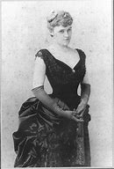
8.love
The kind of love that interests Edith Wharton is of the undreamed, that breaks the monotomy. In the case of Ethan Frome it is a loving triangle and most disapproved by the society of the time, a Puritan society, in which an individual was very sensitive to his reputation.
Ethan isn’t a strong man, he is a victim of environment. She falls in love with Mattie because she sees something different in her, she is always cheerful, she makes him happy.

Slide 10
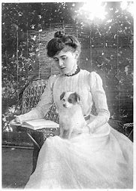
9.Type of love in the novel
In my opinion the type of love in the text is a dangerous love, because it could complicate his own life, could ruin his reputation within society. But it is also a true love, not opportunistic, sincere, because it has no interest. It is almost a ransom from the sad life that Ethan spent, marrying even a woman who disliked

Slide 11
10.Who is the victim?
In my opinion the real victim in the novel is Zenobia. She feels alone and so she marries Ethan. She is not attractive, she looks old, she is unsociable, she doesn’t interacted often with her husband
She understands that her husband in attracted to Mattie, so she wants to send Mattie away. She seems a bit cruel but it’s not easy to bear the fact that one’s husband loves another woman, over all her cousin
After Ethan and Mattie’s smash-up, Ethan becomes invalid and Mattie paralized. In the past she wanted that her husband looked after her because she pretended to be ill. And now Zenonia has to look after them because they aren’t self-sufficient.

Slide 12
https://wsimag.com/it/cultura/9866-edith-wharton
https://www.goodreads.com/author/show/16.Edith_Wharton
http://lacapannadelsilenzio.it/edith-wharton-la-scrittrice-caustica-e-tagliente-dellaristocrazia-americana/

