Slide 1
Giulia Ustulin 5 N LSU

Slide 2
Table of contents
Purpose of work
Introduction
History of human rights
Rights in the constitution

Slide 3
A right: 1. consists of freedom of some kind 2. it is something that awaits man because he or she is a human being 3.is called human rights because they are universal
IINTRODUCTION

Slide 4
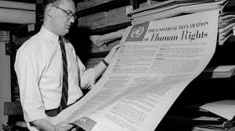
History of human rights
On 10 December 1948 the universal declaration of human rights was signed by the United Nations

Slide 5
During the historical ages the concept and the content of human right has evolved:
Greece and Ancient Rome
Feudalism
Declaration of independence of the colonies
United Nations Organization

Slide 6
There are forms of human rights violations in every part of the world: Torture and ill-treatment Unfair trials Limits in freedom expression
VIOLATION OF HUMAN RIGHTS

Slide 7
Rights in the constitution
Establishes the fundamental principles of civil coexistence
Defines the rules of democratic life from a double point of view:
- citizens' rights in their complex civil, ethical-social, economic and political relationships;
- the organization of state powers;

Slide 8
ARTICOLO 3
“Ogni individuo ha diritto alla vita, alla libertà ed alla sicurezza della propria persona”
“Everyone has the right to life, freedom and security of their own person "

Slide 9
In 2007: in Afghanistan 6.500 people were killed in Brasil 1260 individuals were killed by the police in Uganda 1500 people die every week in internal refugee camps
Violation of article 3 of the constitution

Slide 10
Industrial Revolution

Slide 11
Rosso Malpelo

