Slide 1
EDITH WHARTON
1862-1937

Slide 2
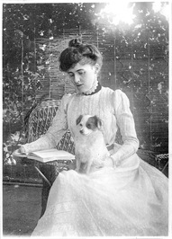
Edith Wharton was an American novelist, short story writer, playwright, and designer.
She was born in Edith Newbold Jones in an upper- class society that is treated in her stories and novels.

Slide 3
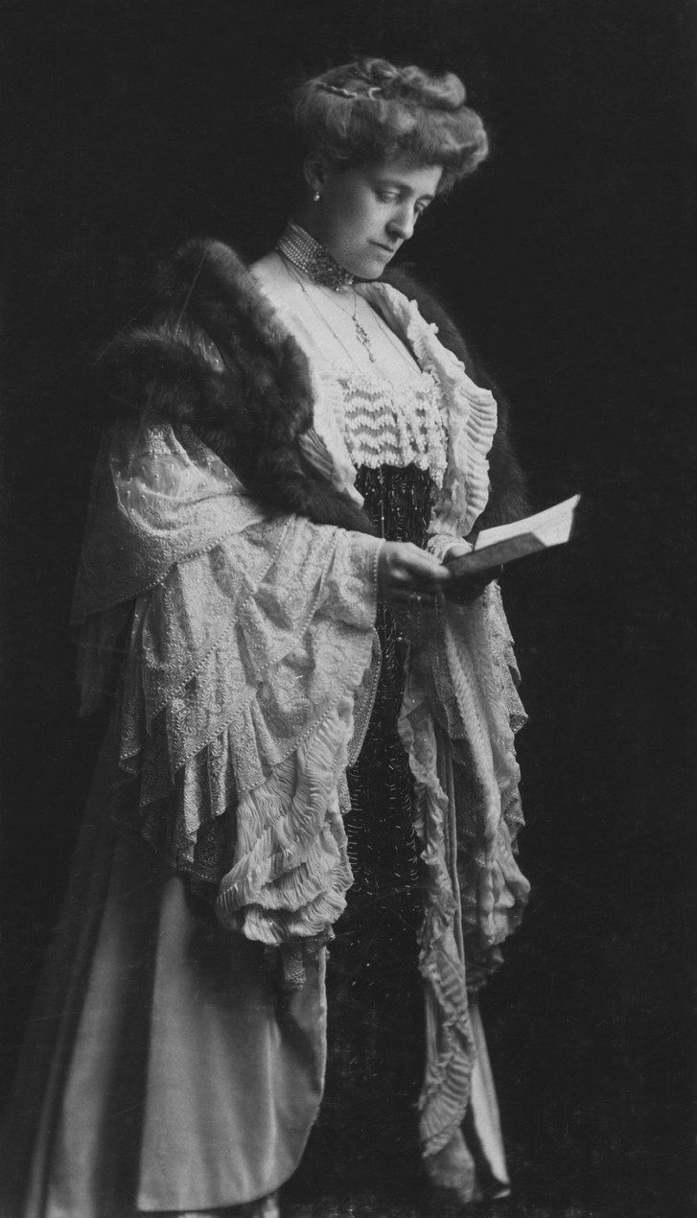
She came from a wealthy New York family. At the time women were discouraged from achieving anything beyond a proper marriage. She broke through these strictures to become one of America’s greatest writers.

Slide 4
THEMES
Wharton treated many of the issues of her own life
in her fiction:
her estrangement and anger at her mother;
her frustration with the limitations placed on women,
her miserable marriage and the stigma against divorce,
her fear of the ways in which cautiousness and selfishness can corrupt one's soul

Slide 5
NARRATORS
In Ethan Frome there are two narrative schemes to tell the tale. In the Prologue and Epilogue the narrator is speaking in the first person. In between the story is telled by a third person narrator, Ethan.
For the first person narrator he refers to himself as “I” and he is omniscent.
Example: “I had the story bit by bit…”
“It was there that I saw him for the first time”

Slide 6
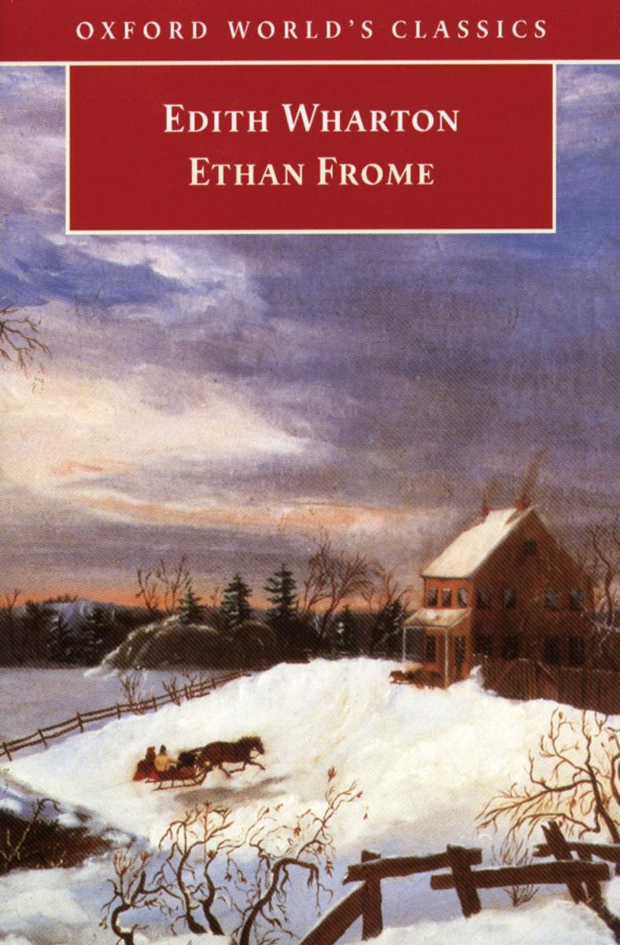
For the third person narrator the reader is seeing the events thruough his eyes.
Examples: “Young Ethan Frome walked at a quick pace along the deserted street”
“Frome's heart was beating fast”

Slide 7
LOVE ANALSIS
In the novel the theme of desire is really strong. There’s an unhappy marriage and an innocent love.
The characters are stuck in a bitter love triangle from which escape is impossible. Ethan is in love with Mattie because his wife Zeena couldn’t give him the warmth that he longs for

Slide 8
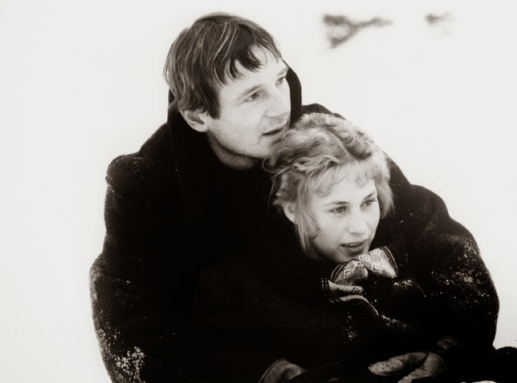
When Ethan is with Mattie he can see a future for himself as happy as the one he lost with his parents.
The love in this novel is treated like a failure. The death of Ethan’s parents, then there’s an unhappy marriage and when Ethan seems to find a sparkle of love in Mattie, it’s impossible to live.

Slide 9
ETHAN’S ANALYSIS- THE VICTIM
In his youth, Ethan is a bright young man who has an aptitude for technology and engineering. He is shown to have a deep attachment to nature and often finds comfort in the landscape around him.
The first real taste of misfortune for Ethan comes when his father is kicked in the head by a horse. This will led the family to poverty.
Later, his mother is afflicted with an illness that causes her to fade both mentally and physically. So, the many doors that were open to him are closed.

Slide 10
His desire to recreate the happy relationship that his parents had years ago is not met in his relationship with Zeena. When Ethan is with Mattie he can see a future for himself as happy as the one he lost in Florida.
When his mother dies, Ethan marries Zeena out of a sense of obligation and perhaps loneliness.
Mattie's character is loving and light. She brings love, but because of their prohibited love they will be under the control of Zeena for their condition.

