Slide 1
ETHAN FROME
Edith Wharton
Jessica Dri 5^NLSU a.s. 2018/2019

Slide 2
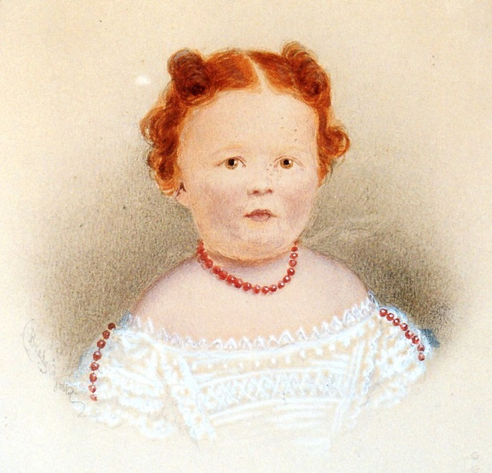
The novelist → edith wharton
She was born on January 24,1862
She came from an aristocratic, puritan New York family
She spent much of her childhood in Europe, France, Germany and Italy
Developed both her gifts for languages and a deep appreciation for beauty; in art, architecture and literature
She became an american novelist

Slide 3
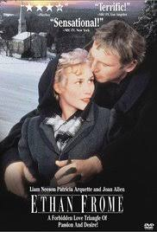
The influence of puritanism
Probably the novelist wants to show us the reality of world, we can’t believe in something that will never happen
She described things like they were in her time, the reality
She was influenced by her religious values writing the novels because since she was a baby, she grew up with this kind of mentality that contributed to shape her point of view

Slide 4
Themes
Impossible love → between Ethan and Mattie
Solitude → pushing Ethan and Zenobia marry each other
Society’s restrictions → moral values
Status of women within the comunity → they hadn’t rights
Comparation between old (Zeena) and young (Mattie)
Suicide → they tried to commit suicide rather than continue living in this way
Sickness → at the beginnig of the long, short story Ethan’s mother was sick and found comfort in the figure of Zeena who, in turn, became ill
Forgiveness → Zeena forgave their behavior and help them

Slide 5
Descriptions
The novelist uses the technique of description to make the story more realistic
She shows us how a detailed description can make the reader undertand the setting
The readers can built the characters’ images on their mind so they can identify themselves with
The setting creates a perfect balance between feelings and the environment
“It was not so much his great height that marked him, for the “natives” were easily singled out by their lank longitude from the stockier foreign breed: it was the careless powerful look he had, in spite of a lameness checking each step like the jerk of a chain.”
“If you know the post-office you must have seen Ethan Frome drive up to it, drop the reins on his hollow-backed bay and drag himself across the brick pavement to the white colonnade; and you must have asked who he was.”

Slide 6
narrators
There are different kind of narrator in this long, short story:
In the prologue and at the end of the novel in the epilogue, the narration is in the first person therefore he prefers to be anonymous and he says to have the story, bit by bit, from various people which interviewed then he remains out of the story
Whereas the chapters are narrated in the third person omniscent
Jotham Powell: the hired man on the Frome’s farm
Harmon Grow: a former stage-driver
Denis Eady: cheerful young man who admires and flirts with Mattie

Slide 7
Examples
“I had the story, bit by bit, from various people, and, as generally happens in such cases, each time it was a different story.” → FIRST PERSON NARRATOR
“Guess he's been in Starkfield too many winters.” Before my own time there was up I had learned to know what that meant. → FIRST PERSON NARRATOR
“The winter morning was as clear as crystal. The sunrise burned red in a pure sky, the shadows on the rim of the wood-lot were darkly blue, and beyond the white and scintillating fields patches of far-off forest hung like smoke.”→ THIRD PERSON NARRATOR
“I had been sent up by my employers on a job connected with the big power-house at Corbury Junction, and a long-drawn carpenters' strike had so delayed the work that I found myself anchored at Starkfield—the nearest habitable spot—for the best part of the winter.” → FIRST PERSON NARRATOR
“Ethan set about unloading the logs and when he had finished his job he pushed open the glazed door of the shed which the builder used as his office. Hale sat with his feet up on the stove, his back propped against a battered desk strewn with papers: the place, like the man, was warm, genial and untidy.”→ THIRD PERSON NARRATOR

Slide 8
Different kind of love
Love can be confused with solitude
People sometimes, married in order to stop feeling alone. Is this true love?
Zeena, Ethan’s wife, needs always more attentions → mad love (she didn’t love him, she only wants to fells loved, cured)
Ethan falls in love with Mattie because she was solar, young, attractive but they couldn’t declare their love each other, because of society’s moral values
Maternal love: between Ethan and his mother who was sick and obligated the protagonist to take care of her with the help of Zeena
«I love you is always a quote» cit.

Slide 9
Love in the novel
In my opinion in the novel are represented different kind of love. Love isn’t always something positive, maybe lovers should’t be interested at what people will think or what they will say about their relationship because love is an emotion that should come from the heart and I think this sensation shouldn’t be judged
It can be considered immature trying to commit suicide but probably they didn’t thought upon the consequences and, took by passion, they decided to put an and to their lives

Slide 10
The victim
The real victim of the novel is Ethan’s wife
She is represented like the kind of woman living in this period, when women hadn’t rights then they couldn’t oppose to the moral values of the society
She had to bear her husand’s indifference and in spite of a betrayal, at the end of the story, she continued to take care of them
The novelist did never report the Zeena’s point of view, then the reader can’t understand her sickness but Edith indirectly, makes clear her submission

