Slide 1
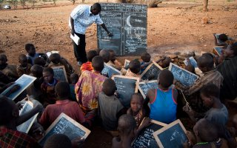
HUMAN RIGHTS
RIGHT TO EDUCATION
PATH CITIZENSHIP AND
CONSTITUTION
ELISA QOSHJA
5NLSU
A.S. 2018-2019

Slide 2
TABLE OF CONTENTS
The aim of Power Point Presentation
Introduction to Human Rights
The background of Human Rights
Human Right’s violetion
Right to education
Human Rights in literature
Sources

Slide 3
AIM
Introduce human rights
Illustrate Huma Rights development and documents trhough history
Focus on right to education
Describe violetion of right to education
Connection between Human Rights and the text

Slide 4
DEFINITION Human Rights are the basic rights and
freedoms that belong to every person
in the world, from birth until death
These rights and freedoms are based on: -dignity
-fairness
-equality
-respect
-indipendence
The rights are: • Universal
• Inalienable
• Indivisible and interdependent.

Slide 5
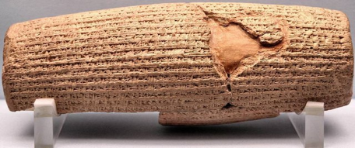
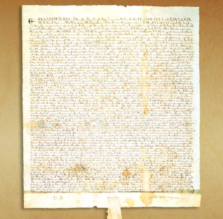
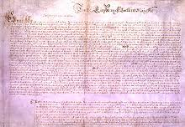
THE BACKGROUND OF HUMAN RIGHTS
The Cyrus Cylinder (539 B.C.)
Magna Carta (1215)
Petition of right (1628)

Slide 6
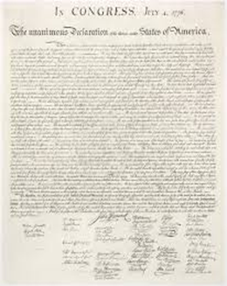
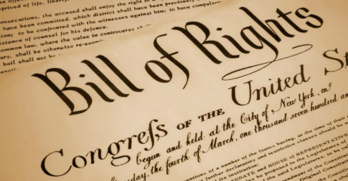
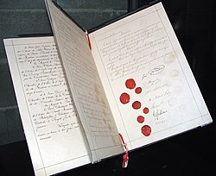
The United States Declaration of
Indipendence (1776)
The Constitution of the United State of America (1787) and the Bill of Rights (1791)
The First Geneva Convention (1864)

Slide 7


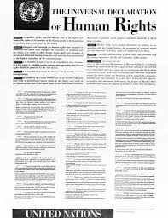
The Declaration of the Rights of
Man and of the Citizen (1789)
The United Nations (1945)
The Universal Declaration of Human Rights
(1948)

Slide 8
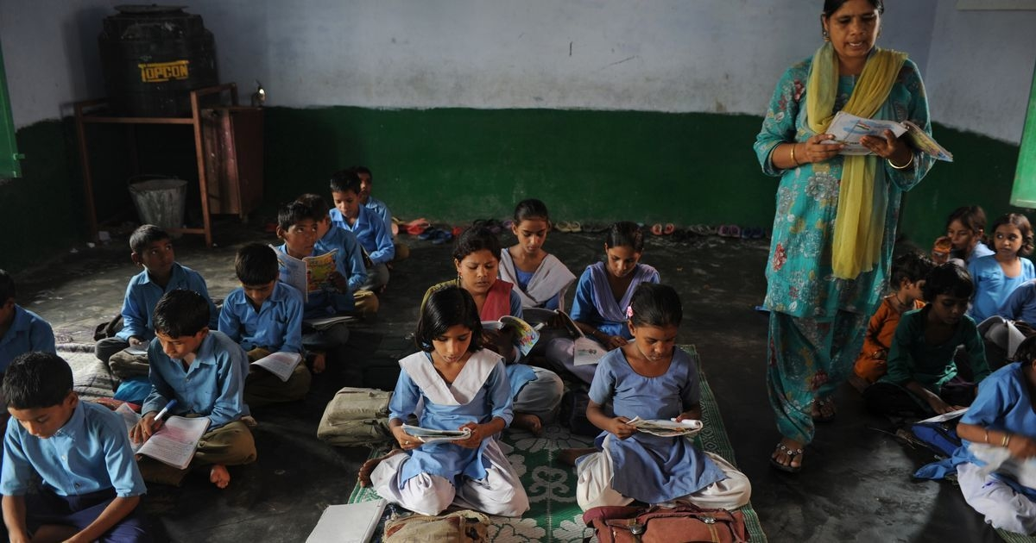
RIGHT TO EDUCATION
The right to education is a fundamental human right. Every individual, irrespective of race, gender, nationality, ethnic or social origin, religion or political preference, age or disability, is entitled to a free elementary education.

Slide 9
This right has been universally recognised since the Universal Declaration of Human Rights in 1948
Article 26.:
(1) Everyone has the right to education. Education shall be free, at least in the elementary and fundamental stages. Elementary education shall be compulsory. Technical and professional education shall be made generally available and higher education shall be equally accessible to all on the basis of merit.
(2) Education shall be directed to the full development of the human personality and to the strengthening of respect for human rights and fundamental freedoms. It shall promote understanding, tolerance and friendship among all nations, racial or religious groups, and shall further the activities of the United Nations for the maintenance of peace.
(3) Parents have a prior right to choose the kind of education that shall be given to their children.

Slide 10
RIGHT TO EDUCATION
ITALIAN CONSTITUTION
Art 33
“The arts and sciences are free, as is their teaching. The Republic lays down general rules for education and establishes all the kinds and levels of State schools. Entities and private persons have the right to establish schools and institutions of education, without State-imposed burdens. The law, in fixing the rights and obligations on non-state schools that request parity, must ensure to these schools full liberty and to their pupils scholastic treatment equal to that of pupils in State schools. State examinations are prescribed for admission to the various kinds and levels of schools as well as for graduation and for qualification to exercise a profession. Institutions of higher learning, universities and academies have the right to establish their own regulations within the limits laid down by the laws of the State.”

Slide 11
ITALIAN CONSTITUTION
Art 34.
“ Schools are open to everyone. Elementary education, imparted for at least eight years, is compulsory and free. Capable and deserving pupils, even those without financial resources, have the right to attain the highest levels of education. The Republic makes this right effective through scholarships, payments to families and other provisions, which must be assigned through competitive examination.”

Slide 12
CONVENTION OF THE RIGHT OF THE CHILD
Article 28
“States Parties recognize the right of the child to education, and with a view to achieving this right progressively and on the basis of equal opportunity”

Slide 13
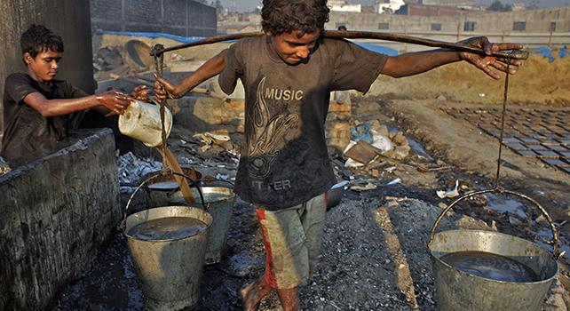
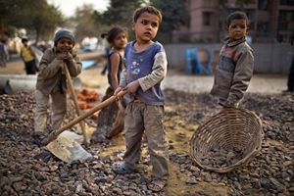
RIGHT EDUCATION’S VIOLETION
UNICEF data: 123 million children do not go to school;
the 40% live in poor area
the 20% live in war zones
There is no money to invest in schools
Many children are forced to work

Slide 14
CONNECTION WITH TEXTS
CHILD LABOUR TODAY
1 in every 7 children is a child labourer
Article 32 (Child labour): “The government should protect children from work that is dangerous or might harm their health or their education. While the Convention protects children from harmful and exploitative work, there is nothing in it that prohibits parents from expecting their children to help out at home in ways that are safe and appropriate to their age. If children help out in a family farm or business, the tasks they do be safe and suited to their level of development and comply with national labour laws. Children's work should not jeopardize any of their other rights, including the right to education, or the right to relaxation and play.”

Slide 15
Article 32
https://www.bing.com/videos/search?q=article+32+of+convention+of+the+rights+of+the+child&qpvt=article+32+of+convention+of+the+rights+of+the+child&view=detail&mid=0969C8E9F923D46448AD0969C8E9F923D46448AD&&FORM=VRDGAR

Slide 16
SOURCES
https://www.amnesty.org.uk/what-are-human-rights
https://www.youthforhumanrights.org/what-are-human-rights/background-of-human-rights.html
http://www.jus.unitn.it/dsg/pubblicazioni/costituzione/costituzione%20genn2008eng.pdf
https://norad.no/en/front/thematic-areas/education/right-to-education/
http://www.famigliacristiana.it/articolo/123-milioni-di-bambini-non-vanno-a-scuola.aspx

