Slide 1
Ethan Frome
By Edith Wharton

Slide 2
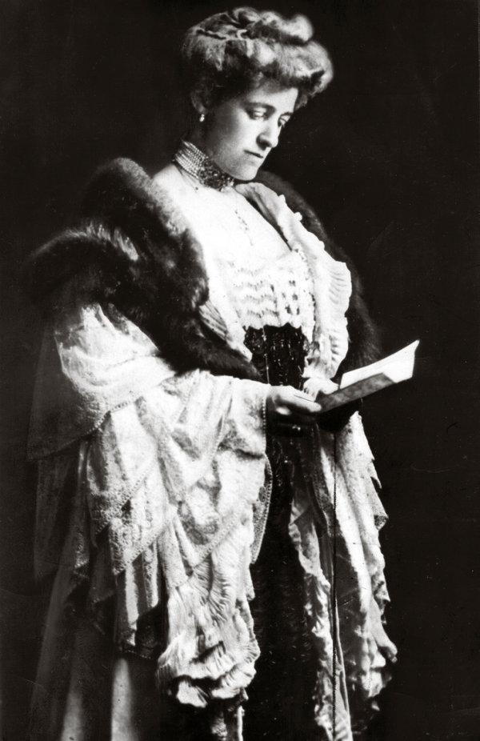
EDITH WHARTON
Edith Wharton was an American writer; she was born in New York in 1862 and she died in 1937
She learned several languages From an early age
She was an introspective and thoughtful girl; she was very interested in reading and studying
Edith wrote her first novel at the age of 14 but she had to lie about her identity as an author
Edith's family was rich and so she had the opportunity to study and travel
Her most important novel was "Ethan Frome" and "The Age of Innocence”

Slide 3
INFLUENCES
The Puritan society → At the time woman was expected to stay at home, they were considered inferior as man
The sickness of her husband
The relationship with her mother
Edith tried to broke the standars behavior of her time through her novels

Slide 4
NARRATIVE THEMES
Sickness → Ethan lives his whole life surrounded by sick people
Puritan society → Need of the individual person to progress in the social class
Love → Edith Wharton wants to make the reader understand how real love is. She does it through the love triangle of Ethan, Zeena and Mattie.

Slide 5
ATTENTION TO DETAILS
For example the setting described by Edith Wharton is cold and dark and immediately transmits a sense of melancholy and sadness to the reader. These atmospheric conditions are a metaphor concerning Ethan’s life
Language is refined
The characters are characterized through different aspects

Slide 6
NARRATIVE VOICES
Prologue
The narrator speaks in first person; his identity is not important
Central part
Epilogue
The narrator speaks in first person
The narrator speaks in third person, the reader can analyze the different points of view, comparing them and creating his own idea

Slide 7
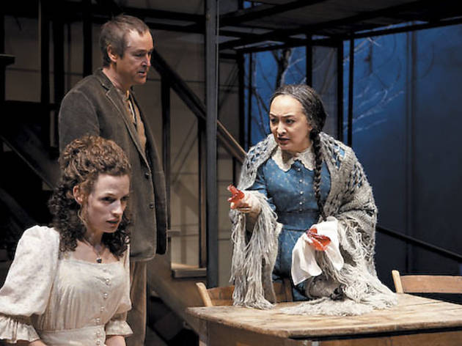
LOVE IN “ETHAN FROME”
Edith Wharton wants to highlight all the human beings’s weaknesses
This "tragic" love is influenced by Puritanism
In the story are presents all the human's feelings: jealousy, infatuation, sense of duty, unconsciousness …

Slide 8
THE VICTIM
ZEENA:
she is judged by the reader during all the novel → a terrible woman who hinders the love between Ethan and Mattie. In reality she was only in a difficult situation.
ETHAN and MATTIE:
at the end of the novel their love turns against them and Zeena gets what she wants → controls Ethan.

