Slide 1
«Ethan Frome» by Edith Wharton
Samantha Giannangeli 5^ NLSU S.Y. 2018/2019

Slide 2
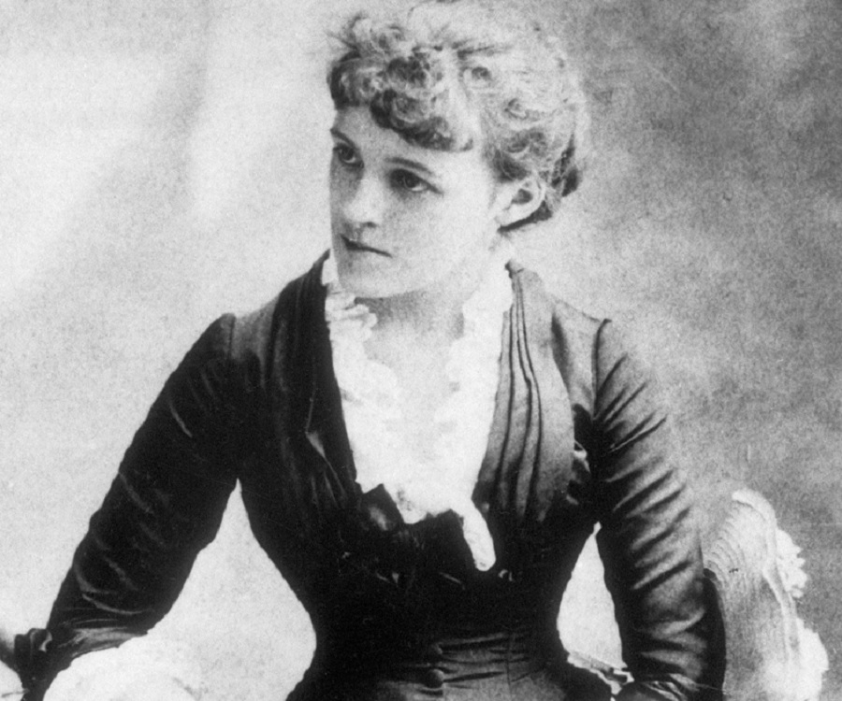
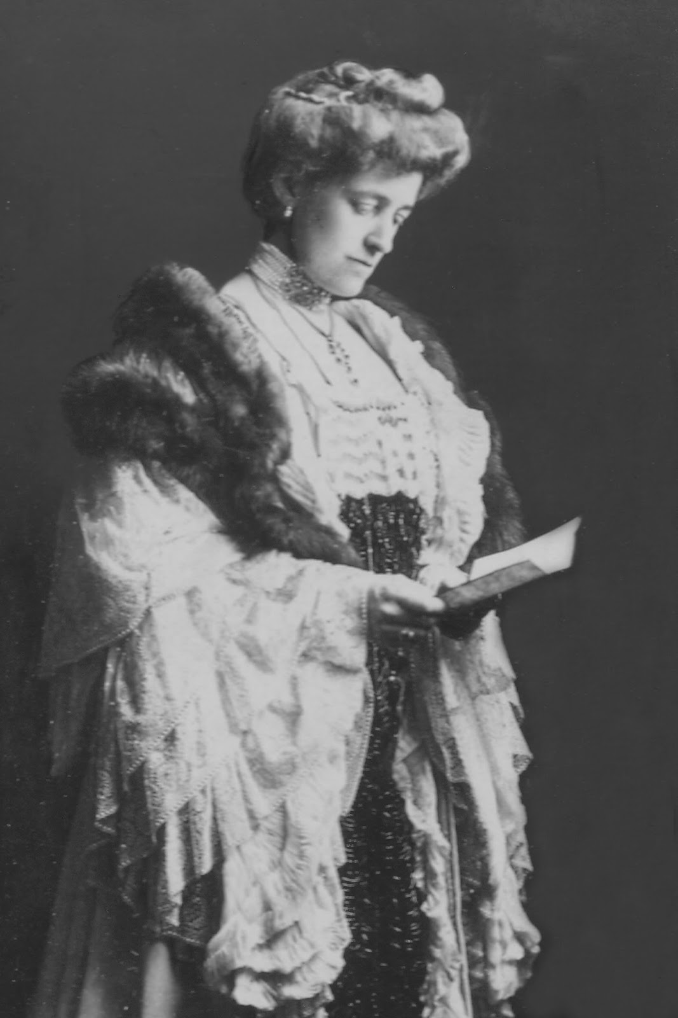
About the novelist
Edith Wharton was born in 1862 in New York. She was an American novelist, short story writer, playwright, and designer. She was the firtst woman to win the Pulitzer Prize for Literature.
She was born during the Civil War: in that period her family started travelling around Europe, so she soon became familiar with German, Italian and French languages. Edith always refused to conform to the etiquette: she wanted to learn more through education so she used to reach for her father’s library.

Slide 3
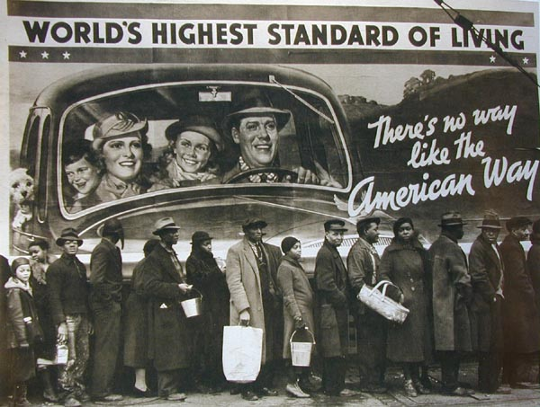
About the novelist
Edith Wharton was born in a wealthy and prestigious family strictly affected by religious and moral values of the Puritan society of that time.
Especially her mother wanted her to follow Puritan rules, for example she forbade her to read novels untill her marriage.
Edith Wharton lived during the Gilded Age, a period of economic growth but also of inequality, poverty and restriction. She critically and realistically wrote about the lives and morals of that age, analysing its values and beliefs.
Glossary:
Puritanism: it derives from «pure»: according to Puritan religion, people must follow the Bible and not commiting sins or showing off, people who belonged to this society had to be modest. Gilded Age: era of extreme economic growth that goes from the 1870 to the 1900. During this period many immigrant came to America, looking for better living conditions.
→ The image shows the huge disparity between the propaganda, that displays the «perfect» American family, and the conditions of misery of African Americans.

Slide 4
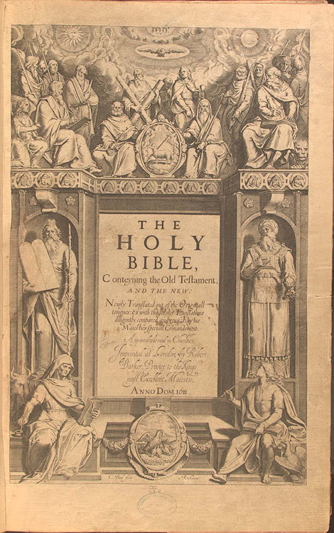
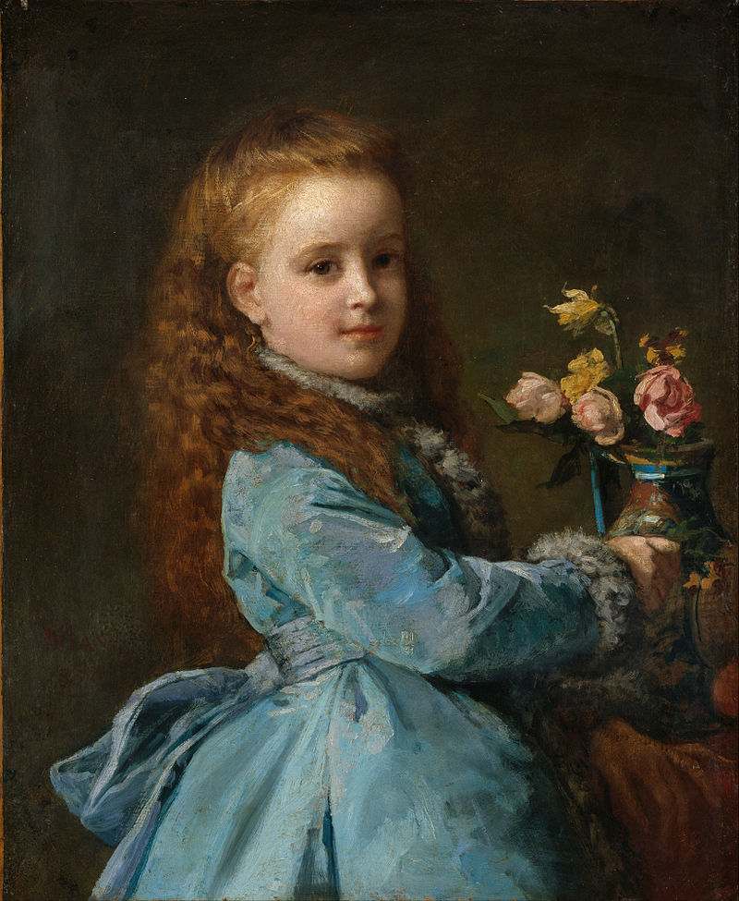
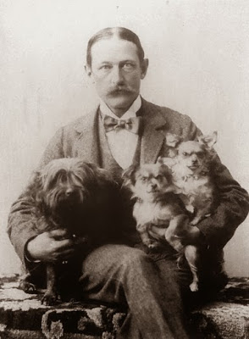
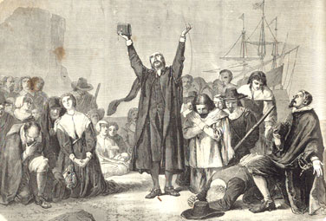
How the environment influenced the novelist
Puritan religion: Puritan values regard a strictly observance of the Bible’s norms. Puritan devoted must not commit sins. In Puritan religion modesty and pureness are the main values. In the novel the characters try to respect these precepts.
Childhood and relationship with her mother: Edith did not want to fit into the typical stereotype of the society woman her mother wanted her to represent. Plus, her mother always criticised her works.
Puritan society: Within Puritan society, reputation is vital. The writer brings these themes into her novels: the protagonists are extremely concerned about their image.
The failed marriage of the novelist deeply influenced her vision of relationships: she tells the readers about collpsed marriages and heart-breaking love stories.

Slide 5
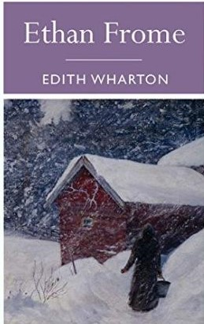
Themes in the novel
Love: The focus of the narration is on the secret love story between Ethan and the young and innocent Mattie. This is a forbidden love, and for this reason it is also incredibly deep and overwhelming. (for a more detailed analysis go to slide 9)
Relevance of Society and Reputation: The protagonists are deeply influenced by the society’s thought and opinion. Ethan can’t leave Zenobia alone and freely live his love for Mattie because of what the Puritan society may think: extraconiugal relationship is considered a sin.
Marriage and Loneliness: Most people are afraid to live alone: this is why Ethan decides to marry Zenobia. Unfortunately, their marriage turns out to be so unhappy, this is why Ethan falls in love with Mattie: she is everything Zeena is not.
Illness: Ethan spends most of his life taking care of ill people: his mother, Zenobia and then Mattie. His disability represent the last obstacle to his fullfillment.
Life or Death: At the end of the novel Ethan and Mattie face a difficult choice: they must decide between staying together (by dying) or living far away from each other.

Slide 6
The descriptions and their functions
The language used by the writer is highly descriptive and detailed;
The writer especially describes the environment and weather conditions: winter season and its cold and snowy climate psychologically and emotionally represents the story and the characters’ feelings; the oppressive and concrete force of climate is strenghten by the sentence «He’s been in Starkfield too many winters»: winter is both a physical and psichologically obstacle;
As regards characters’ descriptions, they can be defined by different elements: Ethan is described through his actions, words, physical appearance, habits and thoughts, whereas Zenobia is only defined by her actions and some dialogues. The descriptive elements influence the reader’s opinion about the character.
Thanks to the detailed descriptions, the reader is able to identify with the characters.

Slide 7
Narrative scheme
First person narrator
Epilogue and prologue;
His role is to explain the narrative technique and tell how the novel was born;
Third person narrator
Chapters;
Omniscent;
The reader is influenced by his point of view;
He makes the reader curious about Ethan’s story.
Not omniscent;
Tells the story by Ethan’s point of view;
The reader only knows what the writer wants to show him.
In the epilogue he makes the reader think about the novel’s message.

Slide 8
Narrative scheme
First person narrator
“I had the story, bit by bit, from various people, and, as generally happens in such cases, each time it was a different story.”
Third person narrator
“I had the sense that the deeper meaning of the story was in the gaps. But one phrase stuck in my memory and served as the nucleus about which I grouped my subsequent inferences: “Guess he's been in Starkfield too many winters.” ”
“Young Ethan Frome walked at a quick pace along the deserted street”
“Mattie Silver had lived under his roof for a year”
It was during their night walks back to the farm that he felt most intensely the sweetness of this communion. He had always been more sensitive than the people about him to the appeal of natural beauty.

Slide 9
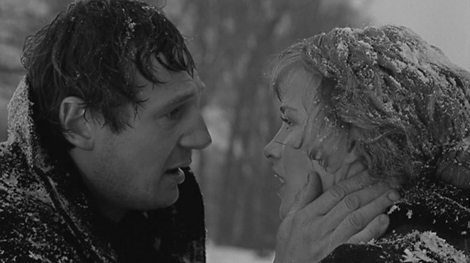
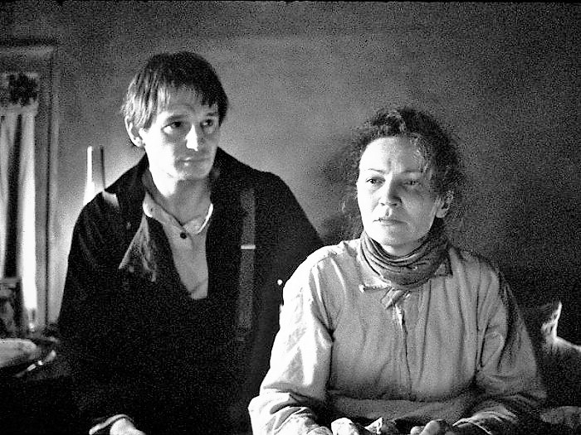
The theme of Love in the novel
Ethan’s love for Mattie: the young girl represents freedom and youthfullness to the protagonists.
Mattie’s love for Ethan: Mattie’s feelings are naive, fresh and enthusiastic.
→ Their love story is passionate and sincere, even if they are not able to physically express it. The impossibility of this love is the reason why it’s so strong and deep.
Ethan and Zenobia’s kind of love is totally different from Ethan and Mattie’s one. Ethan married Zeena because of his fear of loneliness, but his love for her is not true and passionate as his love for Mattie. Their marriage is based on a Puritan religious and social law that can’t be broken, otherwise you are marginalised by the society.

Slide 10
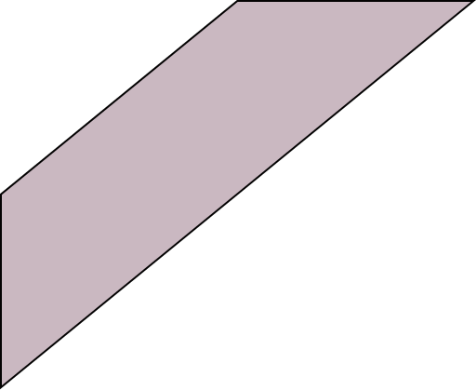
Personal opinion
Ethan’s sudden love for Mattie particularly struck me for its depth and passion.
I felt the protagonist’s true and spontaneous feeling for the girl.
Especially at the end I was impressed by the power of this love, which leads the two characters to attempt suicide.
Actually, I also felt Zeena’s pain and sufference: the writer has been able to make the reader fully dive in the story.
I appreciated the constrast between the two love stories and how the writer reported their reactions, feelings and conditions.

Slide 11
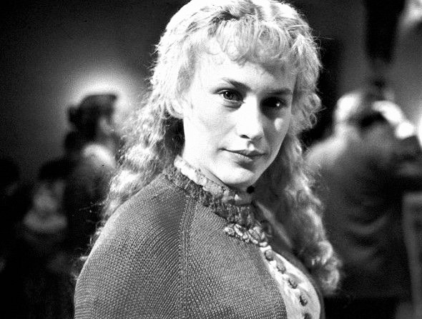
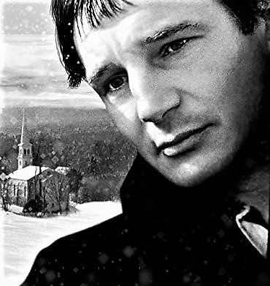
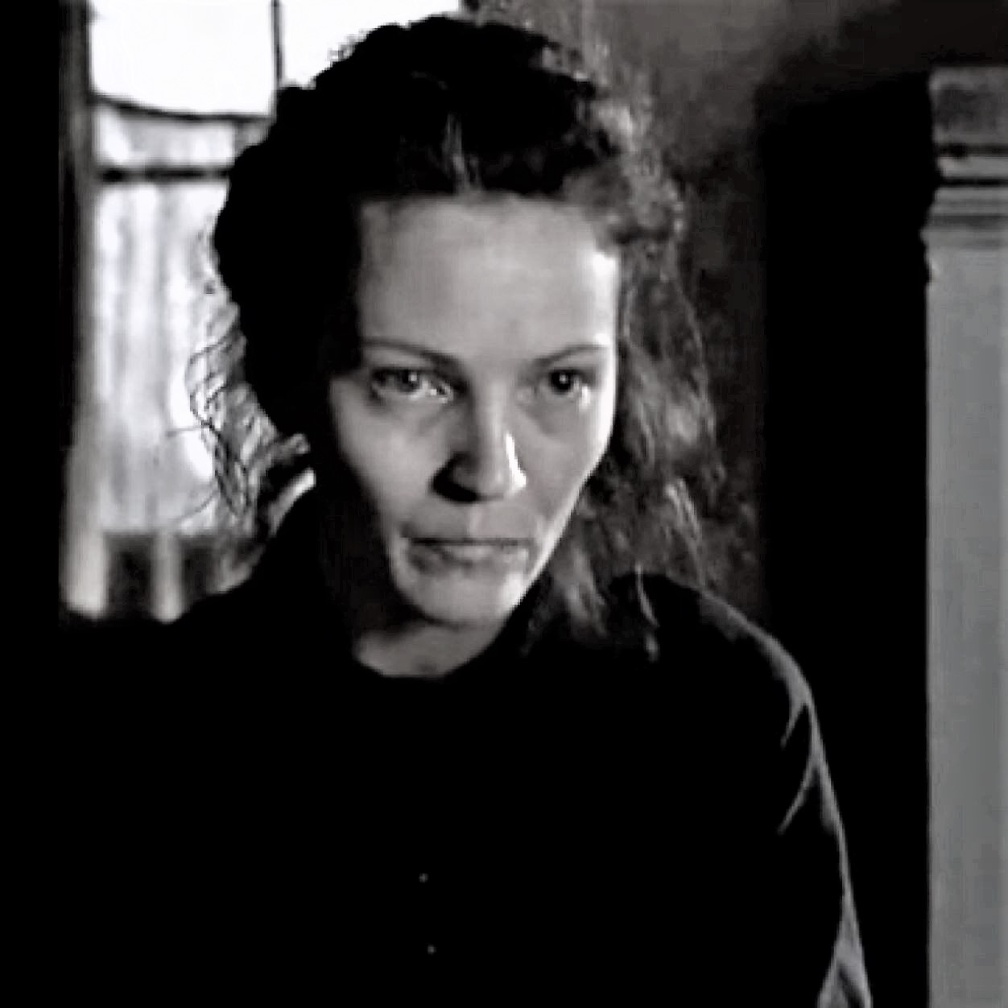
Who’s the victim?
Since the novel is told by Ethan’s point of view, the reader may consider him and Mattie as the two victims of the story.
With a further analysis of the novel the «intelligent» reader understands the relativity of the situations.
Through a deeply reading, the reader can identify with Zenobia and he sees the events through her eyes: she feels abandoned, lonely, old and ignored. Plus, she is confined into her house and her conditions of poverty.
Both Ethan and Zeena are unhappy and unsatisfied with their life and are not able to change it as well.

Slide 12
Sources:
https://www.sparknotes.com/lit/frome/themes/
https://en.wikipedia.org/wiki/Edith_Wharton
https://en.wikipedia.org/wiki/Gilded_Age

