Slide 1
Human Rights and The Italian Constitution
Alessia Cocolin – 5QLSC

Slide 2
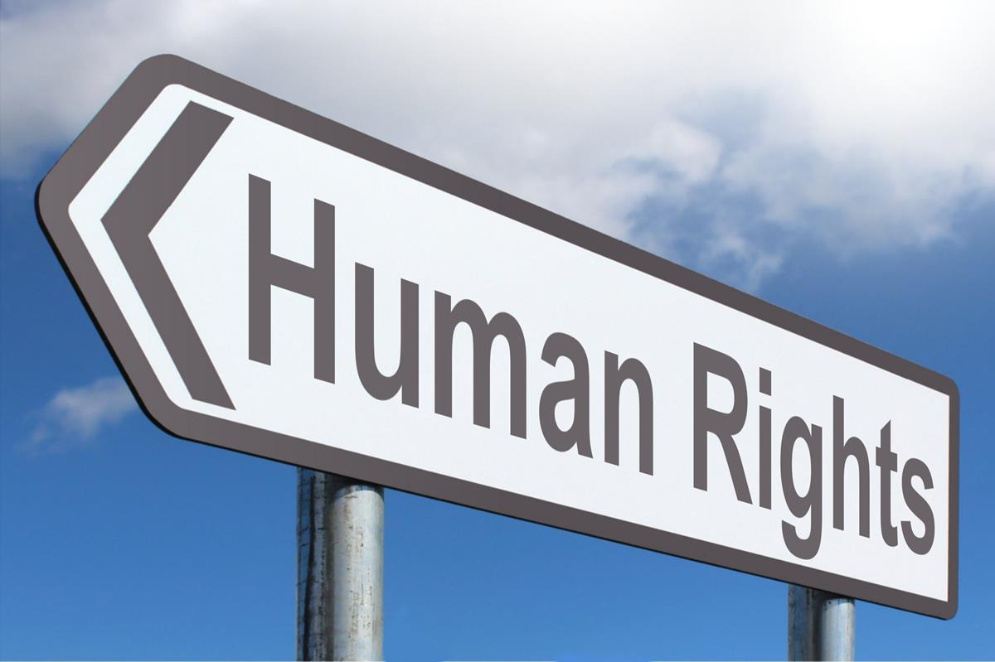
Table of contents
Human Rights in history
The Italian Contitution
Right to education in the Italian Constitution
Right to education in literature
Conclusion
Notes:
Possono essere necessarie più diapositive

Slide 3
Aims
Know more about human rights & the Italian Constitution
Identify examples of Human Rights in literature
Disclose a personal path

Slide 4
History of Human Rights
Magna Charta libertatum
Petition of Right
Declaration of the rights of man and of the citizen
1776
1789
1215
Declaration of Independence of the United States
1628
ITALY
Albertine Statute (1848): a constitution conceded by king Charles Albert of Sardinia; it declared that all citizens are equal and with equal civil and political rights regardless of ranks and titles.
Universal Declaration of Human Rights (1948)

Slide 5
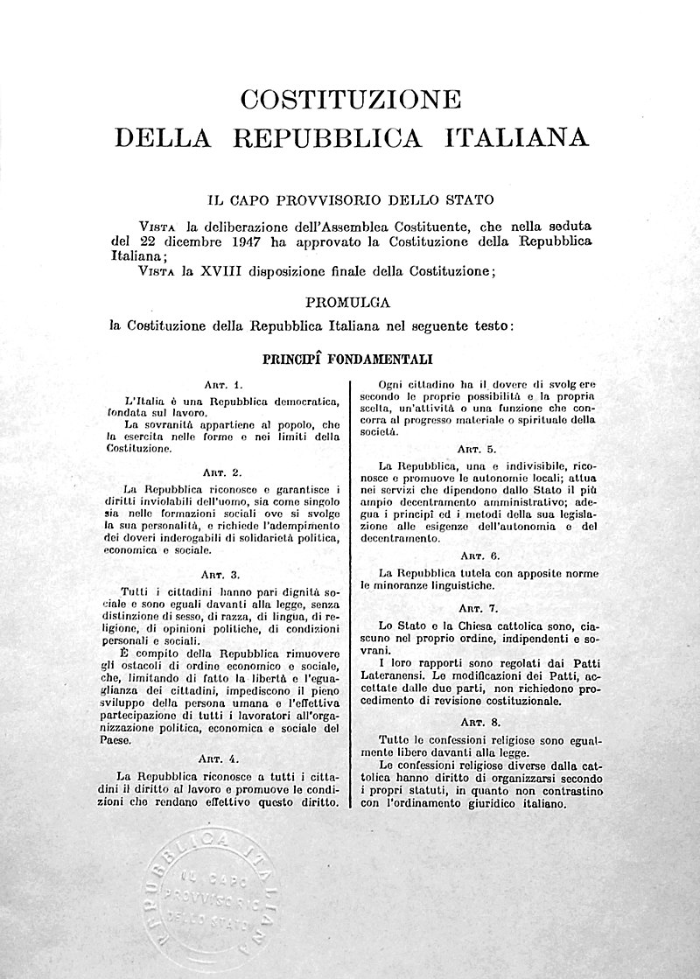
The Italian Constitution
What is the Italian Constitution?
It is the fundamental law at the basis of the Italian state, approved on December 22th 1947.
It is divided into three major parts:
fundamental principles
rights and duties of the citizen
Republic organisation
transient and final dispositions
The Italian constitutions and the Universal Declaration of Human Rights are compatible, but while the first is restricted to a national sphere, the UDHR refers to all human beings.
To know more about UDHR: https://youtu.be/hTlrSYbCbHE

Slide 6
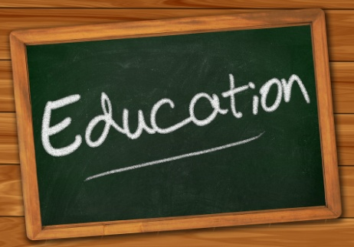
Right to education
ITALIAN CONSTITUTION
Art. 34:“Schools are open to everyone. Elementary education, imparted for at least eight years, is compulsory and free. Capable and deserving pupils, even those without financial resources, have the right to attain the highest levels of education. The Republic makes this right effective through scholarships, payments to families and other provisions, which must be assigned through competitive examination.”
Art. 34 : “La scuola é aperta a tutti. L’istruzione inferiore, impartita per almeno otto anni, é obbligatoria e gratuita. I capaci e meritevoli, anche se privi di mezzi, hanno diritto di raggiungere i gradi più alti degli studi. La Repubblica rende effettivo questo diritto con borse di studio, assegni alle famiglie ed altre provvidenze, che devono essere attribuite per concorso.”
UNIVERSAL DECLARATION OF HUMAN RIGHTS
Art. 26: “Everyone has the right to education. Education shall be free, at least in the elementary and fundamental stages. Elementary education shall be compulsory. Technical and professional education shall be made generally available and higher education shall be equally accessible to all on the basis of merit. Education shall be directed to the full development of the human personality and to the strengthening of respect for human rights and fundamental freedoms. It shall promote understanding, tolerance and friendship among all nations, racial or religious groups, and shall further the activities of the United Nations for the maintenance of peace”.

Slide 7
How does literature deal with education?
The Reluctant Fundamentalist
Growing Up
Revealed: child slaves powered industrial revolution
Oliver Twist
Changez, the protagonist, had the possibility to develop his brilliant mind despite his finances. Thanks to a scholarship he attended the prestigious Princeton University, which gave him an excellent education.
The narrator tells about his sister Doris, who was a clever and skilful girl. He underlines society’s expectations on girls, supposed to be nothing but mothers, wives, nurses or teachers.
Oliver, like many others, lived in a workhouse, which means no education, only exploitation and oppression.
The article exposes the condition of children during the Industrial Revolution; they used to be exploited regardless of their young age, since they were fast-learning and cheap.

Slide 8
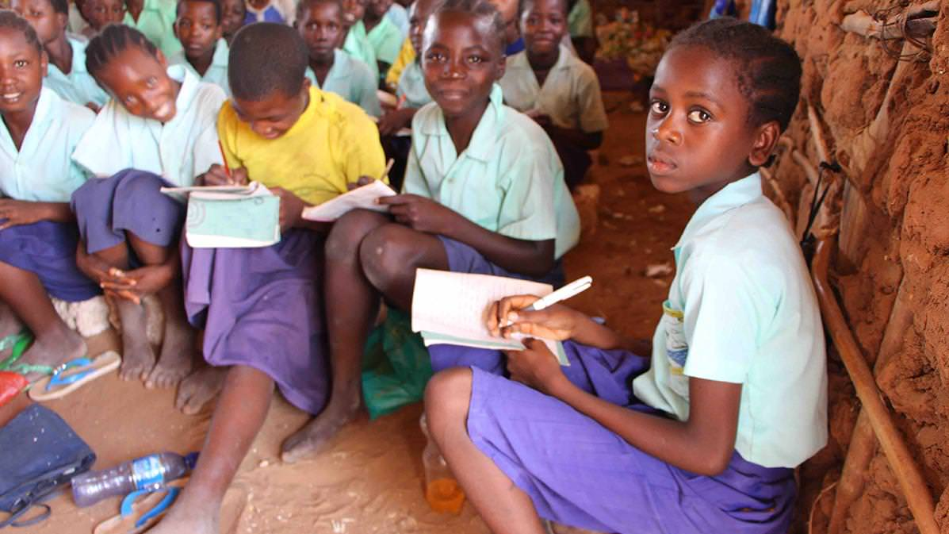
meritocracy
scholarships
mean to improve someone’s social status
The Reluctant Fundamentalist
PURITANISM
Education means:
better social status
bigger aims
fight against disparity
protection
“Growing Up”
“Revealed: child slaves powered industrial revolution”
“Oliver Twist”

Slide 9
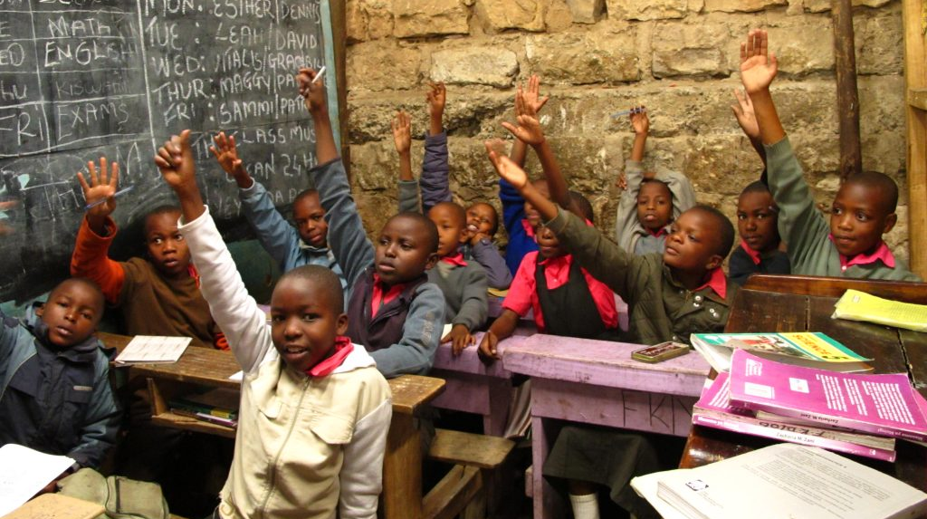
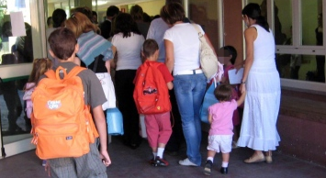
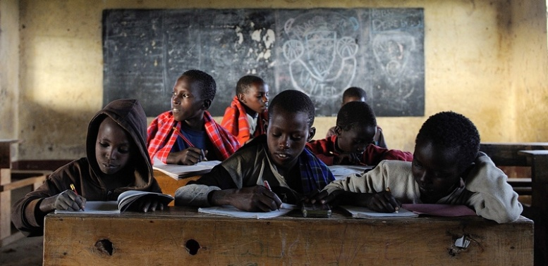
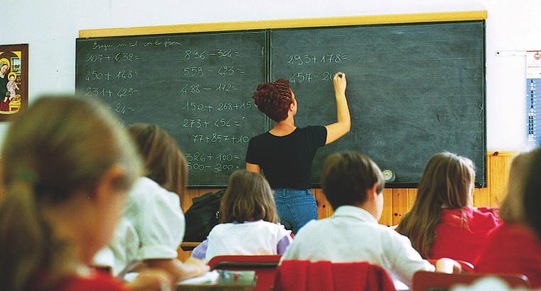
.... And today? Many countries provide deserving students with scholarships and different facilities. In the last years the “Erasmus” program is increased, promoting an intercultural attitude among young people. Education is denied to more than 120 million children: most of them are girls. Education should make us all equal, while it still appears to be synonymous of disparity and imbalance of power.
BUT

