Slide 1
Liceo “A. Einstein” school-year 2018-19
Human Rights in the Italian Constitution and in Literature
Emanuele Concettini V QLSC

Slide 2
Index
What are Human Rights?
The history of Human Rights.
The Universal declaration of Human Rights
Italian Constitution
Human Rights in Italian Constitution
Human Rights in Literature

Slide 3
What are Human Rights?
They are the basic rights and freedoms to which all humans are entitled.
Human rights often includes a lot of civil and political rights.
Some examples of these rights are the rights to:
life,
property,
freedom of expression,
liberty,
pursuit of happiness,
the equality before the law.
Human rights includes also social, cultural and economic rights such as the rights to participate in science and culture, to work and to education.

Slide 4
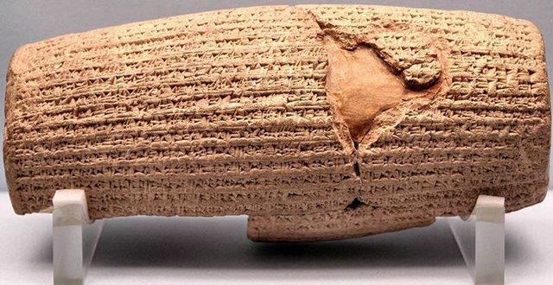
The History of Human Rights
first notice: Cyrus Cylinder (539 B.C.)
the king of Persia, Cyrus the Great conquered the city of Babylon
The king freed the slaves and declared that all people had the right to choose their own religion and established racial equality.
These rights were inscribed in Akkadian language on a baked-clay cylinder.
Cyrus Cylinder, ca. 31cm x 8cm, British Museum, London

Slide 5
Human Rights: sort of Natural Law in India ,Greece and Rome.
Magna Charta: document signed by the King of England in 1215. It represents a turning point in human rights.
It guaranteed a lot of rights that nowadays are considered human ones. It includes:
forbidding bribery and official misconduct;
the rights of all free citizens to own and inherit property and to be protected from excessive taxes;
the right of the church to be free from governmental interference;
The establishment of principles of due process and equality before the law;
The right of widows to choose not to remarry.

Slide 6
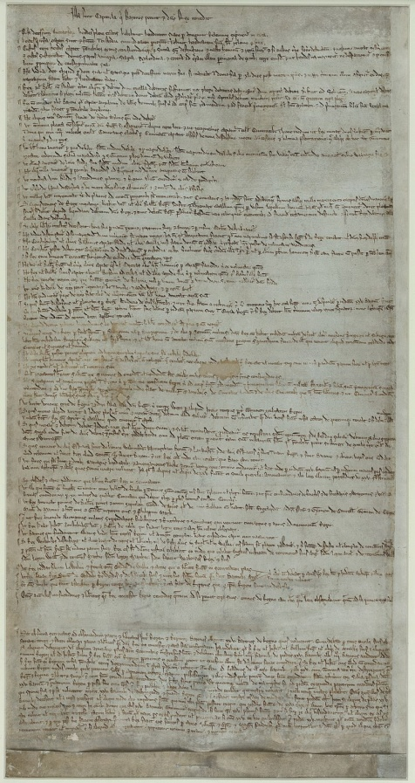
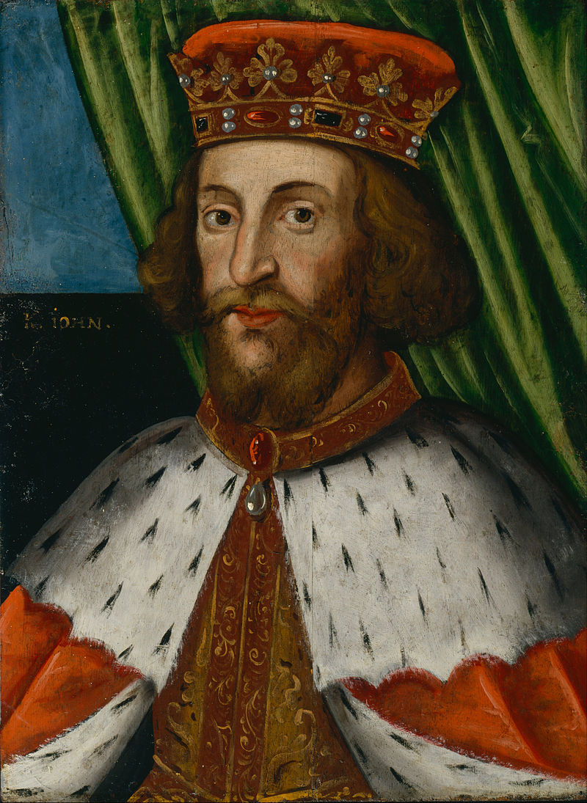
Magna Charta Libertatum, 1215, British Library, London
King John of England, 1199-1216

Slide 7
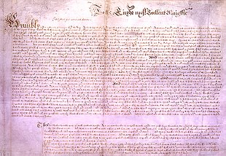
The Petition of Rights: produced in 1628 by the English Parliament and sent to Charles I as a statement of civil liberties.
4 principles:
No taxes may be levied without consent of Parliament;
No subject may be imprisoned without cause shown;
No soldiers may be quartered upon the citizenry;
Martial law may not be used in peace time.
The Petition of Rights, 1628

Slide 8
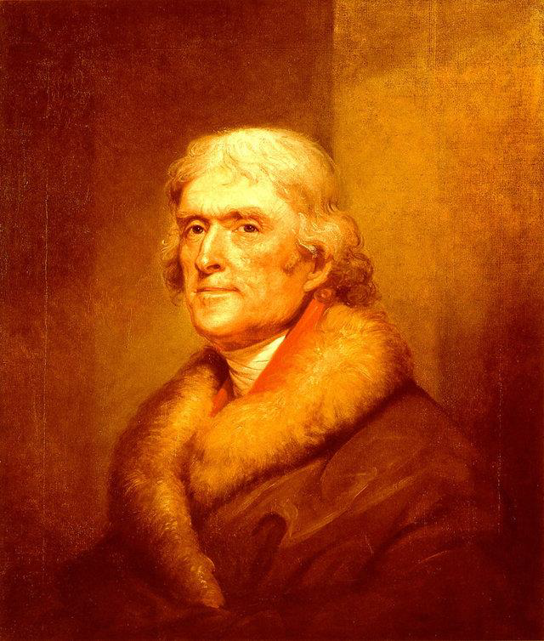
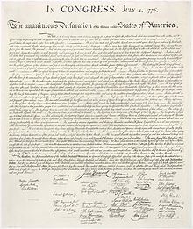
The United States Declaration of Independence (1776): it is used by the American Congress to declare the Independence of the 13 American colonies from the Great Britain.
Two principal themes: individual rights and the right of revolution.
The Declaration of Independence and Thomas Jefferson.

Slide 9
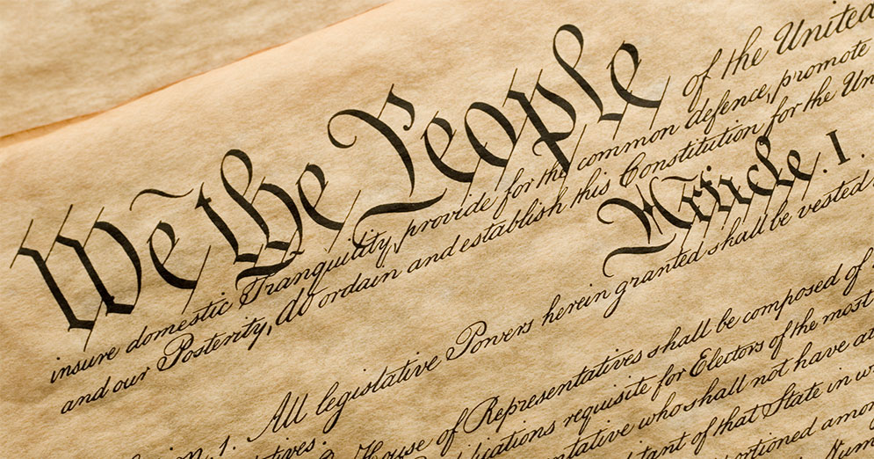
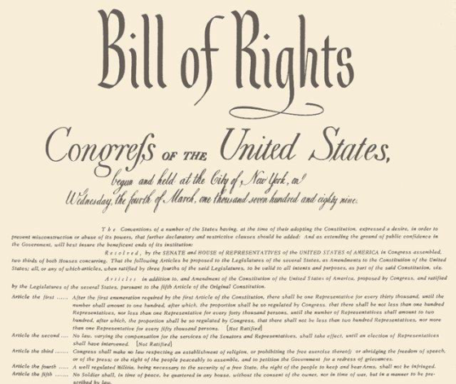
The Constitution of the United States of America (1787) and Bill of Rights (1791): they protect basic freedoms of American citizens.
The Constitution is the fundamental law of the US federal system of government. It is the oldest constitution in use still today. It defines the rights of the citizens, visitors and residents in American territory.
The Bill of Rights protects freedom of speech and religion, the right to keep and bear arms, the freedom of assembly and the freedom to petition. It prohibits the federal government from depriving any person of life, liberty or property without due process of law. The Bill guarantees a speedy public trial with an impartial jury.
The American Constitution and the Bill of Rights

Slide 10
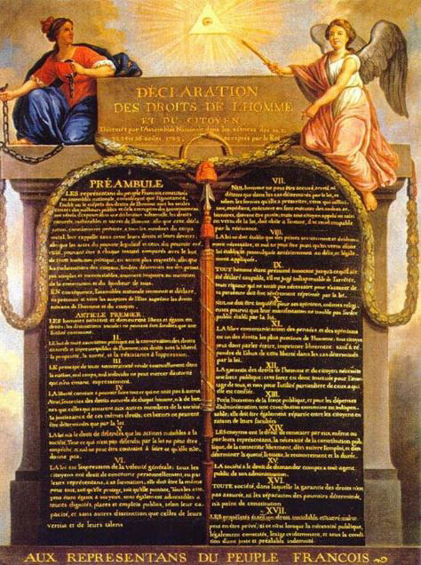
Declaration of the Rights of Man and of the Citizen (1789): following the French Revolution it granted specific freedoms from oppression as “an expression of the general will” intended to promote this equality of rights and to forbid “only actions harmful to the society” . The Declaration proclaims that all citizens are to be guaranteed the rights of “liberty, property, security, and resistance to oppression.”

Slide 11
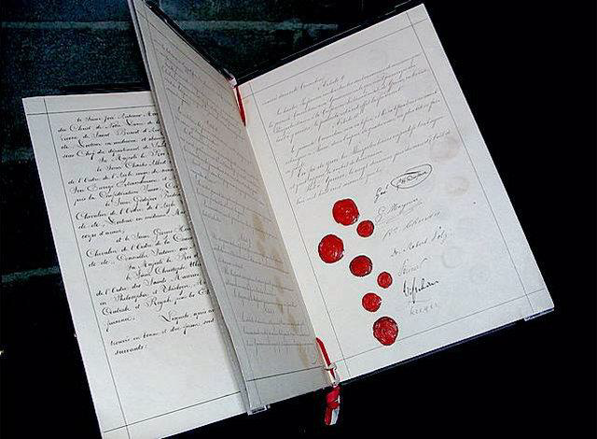
The First Geneva Convention (1864) : it provided for care to wounded soldiers. It provided for the obligation to extend care without discrimination to wounded and sick military personnel and respect for and marking of medical personnel transports and equipment with the distinctive sign of the red cross on a white background .
The first Geneva Convention, 1864

Slide 12
In 1945 50 nations met in San Francisco and formed the United Nations to protect and promote peace in the world. It is an international body created to promote peace and prevent wars. It was born at the end of the Second World War, which caused death, starvation and violence throughout the world.
The Flag of The United Nations

Slide 13
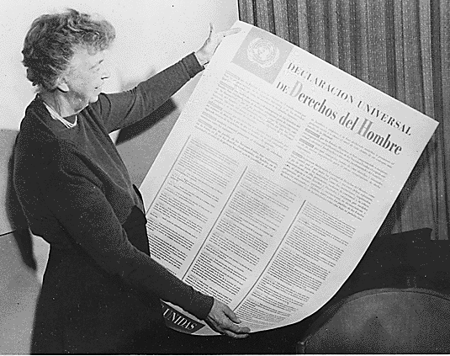
The Universal Declaration of Human Rights (1948) : under the chairmanship of Eleanor Roosevelt, the Declaration was adopted by the United Nations on December 10, 1948. In the preamble and in the Article 1, the Declaration proclaims the rights of all human beings.
“All human beings are born free and equal in dignity and rights”.
This is the first part of the Article 1 of the Declaration.
The Member States of the United Nations worked together to promote the thirty Articles of human rights that, for the first time in history, had been assembled and codified into a single document. In consequence, many of these rights, in various forms, are today part of the constitutional laws of democratic nations.
Eleanor Roosevelt with the Spanish Version of the Universal Declaration of Human Rights

Slide 14
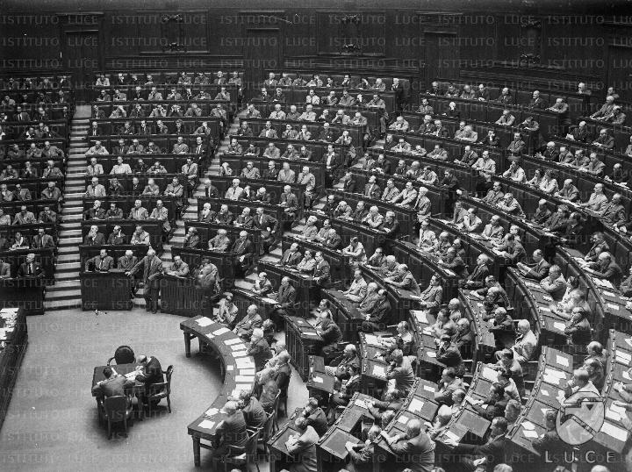
The Italian Constitution
It is the fundamental law of Italian Republic. It was enacted by the Constituent Assembly on 22 December 1947. The Constitution came into force on 1 January 1948, one century after the “Statuto Albertino” had been enacted. The Constituent Assembly was elected by universal suffrage on 2 June 1946, at the same time as a referendum on the abolition of the monarchy.

Slide 15
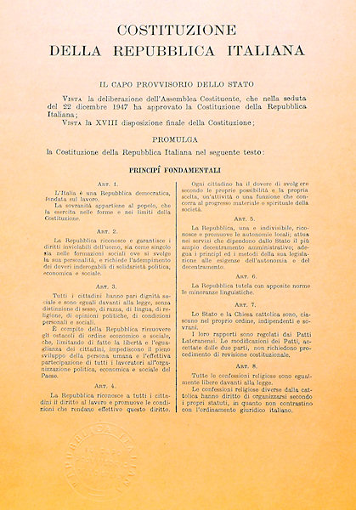
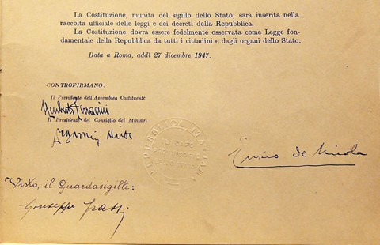
Italian Constitution can be divided into five sections:
The preamble: an introductory and enacting formula;
The Fundamental Principles (articles 1-12);
The Rights and the Duties of Citizens(articles 13-54);
The Organisation of the Republic (articles 55-139);
The Transitory and Final Provisions (provisions I- XVIII).

Slide 16
Human Rights in Italian Constitution
In the second and third part of the Constitution, a lot of rights proclaimed in the Universal Declaration of Human Rights are present.
The articles 1-3 promote an Italy found on work and present human rights. In article 3 it is said that in Italy all people have the same dignity before the law without any kind of discrimination.
In the third section the Constitution guarantees civil rights, political rights, economic rights and social rights. Moreover it regulates the relationship between the citizens and the State.
The Emblem of the Italian Republic

Slide 17
Human Rights in Italian Constitution and in contemporary Literature
Some articles particularly interesting are Articles 1,3, 19,35, 36, 37.
The Article 1 states Italy is a democratic Republic founded on labour. It shows how labour is considered important in Italy as well as in other Western countries, which are influenced by Christian morality, especially by Puritan culture.
References to this article may be found in “The Puritan culture ” extract and in the novel “the Reluctant Fundamentalist”, where it is shown how working has a strong role in American society, which represents all the Western societies. Moreover references to the theme of work is present in “Growing up” and in quite all the novel of Charles Dickens.

Slide 18
The Article 3 is one of the most important of the whole Constitution. It says that all citizens have equal social dignity and are equal before the law, without distinction as to sex, race, language, religion, political opinions, or personal or social condition. This article presents some human rights stated in the Universal Declaration of Human Rights of 1948.
Linked with the theme of the article are some texts such as “Growing up”, where girls are discriminated and are not given the same opportunities of boys; “Lispeth” where the protagonist is treated different from British girl, because she came from an Indian family and “The Reluctant Fundamentalist” where Changez, at the end of the narration, is considered dangerous for the society, because he is Muslim and he is a Pakistani man.

Slide 19
The Article 19 deals with religious faith. It states that all have the right to profess freely their own religious faith in whatever form, individual or collective, to propagate it and to exercise it in a private or public cult, provided that the rites are not contrary to public morals.
References to the article can be found in the text “Is America still Puritan?”, when it is presented the typical Puritan culture and the description of the Puritans. They were a group of Christian people, who wanted to purify the religion. For this reason they were persecuted by the King of England and they were forced to go to the American coast with the “Mayflower” in 1620. There they established and founded a nation, whose characteristics are based on Puritan culture and mentality.

Slide 20
The Article 35 deals with labour, the protection of Italian labour and the freedom to emigrate in order to labour. Moreover it presents the importance of improvement of workers.
References to this article can be found in all the text dealing with Puritan mentality and culture, because for them achievement and progress on social and work ladder are fundamental; in the text “The chief of the Industrial Revolution”, because a lot of farmers in the 18 century were forced to leave the land in order to settle in the city to work as workers in the industries; and in “The Reluctant Fundamentalist” , where the protagonist left his birth-country to go to study and work in the USA.

Slide 21
The Article 36 deals with the rights of workers. It states: “Workers have the right to wages in proportion to the quantity and quality of their work and in all cases sufficient to ensure them and their families a free and dignified existence. The maximum working day is fixed by law. Workers have a right to a weekly rest day and paid annual holidays. They cannot waive this right.”
The theme of the worker’s rights is developed in the text “The Chief features of the Industrial Revolution” and in the article “Revealed: Industrial Revolution was powered by child slaves.”, published on The Independent in 2010. Both deals with the work condition of workers in 18 century. As regards fiction this theme is the focus of some of Charles Dickens’ Novels, such as “Oliver Twist” and “Hard Times”. There the novelist described the terrible conditions in which children were forced to work during the Victorian age.

Slide 22
The Article 37 deals with women’s work and minors’ work. It states: “Working women have the same rights and, for equal work, the same wages as working men. Working conditions must allow women to carry out their essential role in the family and ensure particular and adequate protection for the mother and the child. The law establishes the minimum age for paid labour. The Republic protects the work of minors by means of special provisions and, for equal work, guarantees them the right to equal pay.”
References to this Article can be found in “Growing up”, where the girls were not given the same opportunities of the boys. It is a discrimination of women. The second part of the article deals with the theme focused by Dickens’ novel “Oliver Twist”, which is set in an historical period in which it was considered normal to send children of 8 years to work as chimneysweepers. It shows that in 1800 there was not a minimum age for paid labour. Moreover a lot of young workers were not paid, but they received a little food and a place to sleep in the workhouses.

