Slide 1
HUMAN RIGHTS

Slide 2
HUMAN RIGHTS
“Human rights are rights inherent to all human beings, regardless of race, sex, nationality, ethnicity, language, religion, or any other status. Human rights include the right to life and liberty, freedom from slavery and torture, freedom of opinion and expression, the right to work and education, and many more. Everyone is entitled to these rights, without discrimination.”
United Nations

Slide 3
HUMAN RIGHTS
Introduction
Human rights are the basic rights and freedoms that belong to every person in the world, from birth until death. They apply regardless of where you are from, what you believe or how you choose to live your life.
These basic rights are based on shared values like dignity, fairness, equality, respect and independence. These values are defined and protected by law.

Slide 4
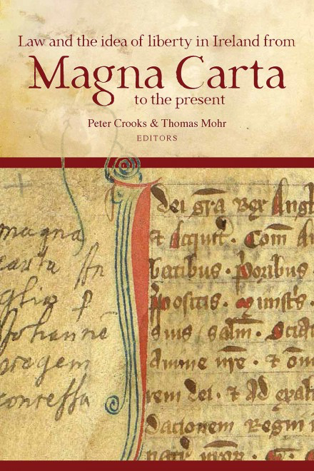
HUMAN RIGHTS
History
Documents asserting individual rights, such the Magna Carta (1215), the English Bill of Rights (1689), the French Declaration on the Rights of Man and Citizen (1789), and the US Constitution and Bill of Rights (1791) are the written precursors to many of today’s human rights documents.
Yet many of these documents, when originally translated into policy, excluded women, people of color, and members of certain social, religious, economic, and political groups.

Slide 5
HUMAN RIGHTS
History
In 1919, countries established the International Labor Organization (ILO) to oversee treaties protecting workers with respect to their rights
The idea of human rights emerged stronger after World War II. The extermination by Nazi Germany of over six million Jews, Sinti and Romani (gypsies), homosexuals, and persons with disabilities horrified the world.
Governments then committed themselves to establishing the United Nations, with the primary goal of bolstering international peace and preventing conflict.

Slide 6
HUMAN RIGHTS
History
the UN established a Commition on Human Rights and charged it with the task of drafting a document spelling out the meaning of the fundamental rights and freedoms proclaimed in the Charter.
On December 10, 1948, the Universal Declaration of Human Rights was adopted by the 56 members of the United Nations. The vote was unanimous, although eight nations chose to abstain.

Slide 7
HUMAN RIGHTS
History
In addition to the covenants in the International Bill of Human Rights, the United Nations has adopted more than 20 principal treaties further elaborating human rights.
In Europe, the Americas, and Africa, regional documents for the protection and promotion of human rights extend the International Bill of Human Rights.

Slide 8
HUMAN RIGHTS
Italian Constitution
Human rights are present in the Italian Constitution in the firts part, called “Fundamental Principles”.
Articles 3,4,6,8 and 10 specify some aspects about Human Rights in our country.

Slide 9
HUMAN RIGHTS
Italian Constitution
Art. 3:
Tutti i cittadini hanno pari dignità sociale e sono eguali davanti alla legge, senza distinzione di sesso, di razza, di lingua, di religione, di opinioni politiche, di condizioni personali e sociali.
È compito della Repubblica rimuovere gli ostacoli di ordine economico e sociale, che, limitando di fatto la libertà e l'eguaglianza dei cittadini, impediscono il pieno sviluppo della persona umana e l'effettiva partecipazione di tutti i lavoratori all'organizzazione politica, economica e sociale del Paese.

Slide 10
HUMAN RIGHTS
Texts
Human rights are present in some texts we analysed so far.
For example, in “Oliver wants some more”, an extract taken from Chapter 2 of Oliver Twist, Charles Dickens show some children who live in very desperate conditions in a work house.
Here the master doesn’t respect the dignity of the children which is a fundamental part of the Declaration of Human Rights.

Slide 11
HUMAN RIGHTS
Texts
Another short story linked to Human Rights is Lispeth by Rudyard Kipling.
The novelist shows a substantial difference between Western and Indian conception about wedding.
Nowadays the possibility of marry another person without restrictions in protected by most of the countries.

