Slide 1
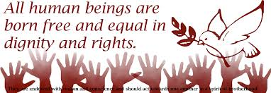
Giorgia Iannucci 5QLSC
HUMAN RIGHTS

Slide 2
INDEX:
What are Human Rights?
How were Human Rights Born?
The Constitution of the Italian Republic
The Italian Constitution’s fundamental rights

Slide 3
WHAT ARE HUMAN RIGHTS?
According to the United Nations’ definition of Human Rights:
“Human rights are rights inherent to all human beings” from birth until death, “regardless of race, sex, nationality, ethnicity, language, religion, or any other status. Human rights include the right to life and liberty, freedom from slavery and torture, freedom of opinion and expression, the right to work and education, and many more. Everyone is entitled to these rights, without discrimination.” They cannot be taken away, although they can sometimes be restricted due to violation of the law or to danger to national security.

Slide 4
HOW WERE HUMAN RIGHTS BORN?
THE CYRUS CYLINDER (539 B.C.)
THE SPREAD OF HUMAN RIGHTS to India, Greece and Rome.
THE MAGNA CARTA (1215)
PETITION OF RIGHT (1628)
UNITED STATES DECLARATION OF INDEPENDENCE (1776)
THE CONSTITUTION OF THE UNITED STATES OF AMERICA (1787) AND BILL OF RIGHTS (1791)
DECLARATION OF THE RIGHTS OF MAN AND OF THE CITIZEN (1789)
THE FIRST GENEVA CONVENTION (1864)
THE UNITED NATIONS (1945)

Slide 5
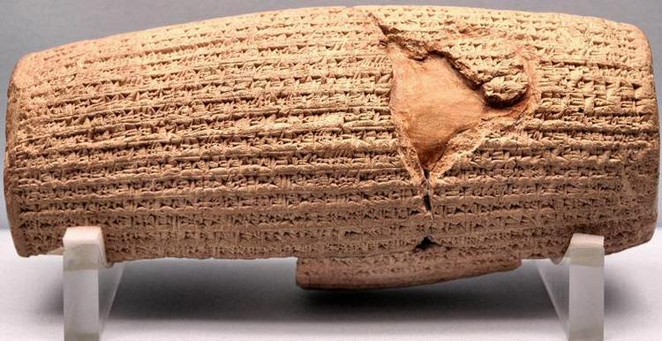
THE CYRUS CYLINDER (539 B.C.)
Cyrus the Great, the first king of ancient Persia, declared human rights in 539 BC, establishing racial equality. The decrees were recorded on a baked-clay cylinder in the Akkadian language with cuneiform script.

Slide 6
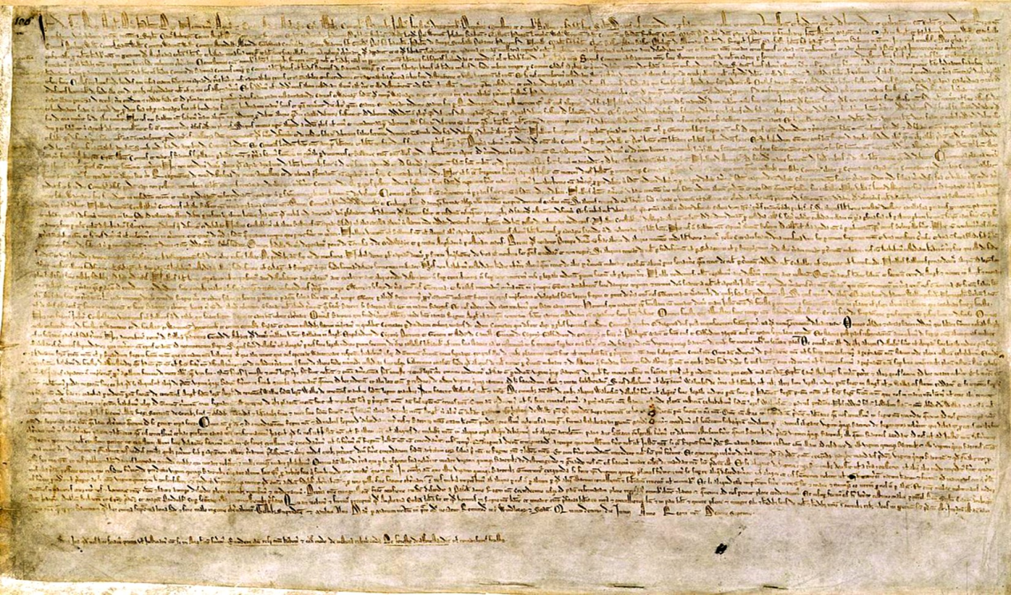
THE MAGNA CARTA (1215)
In 1215, King John of England’s subjects forced him to sign the Magna Carta, which enumerates what later came to be thought of as human rights.

Slide 7
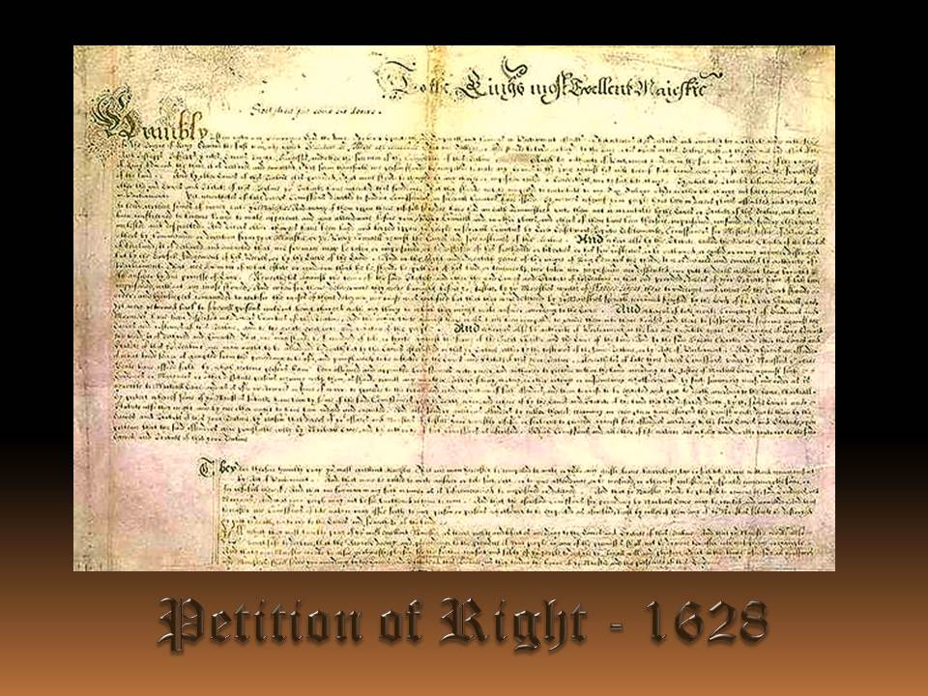
PETITION OF RIGHT (1628)
In 1628, the English Parliament produced the Petition of Right , a statement of civil liberties, and sent it to Charles I.

Slide 8
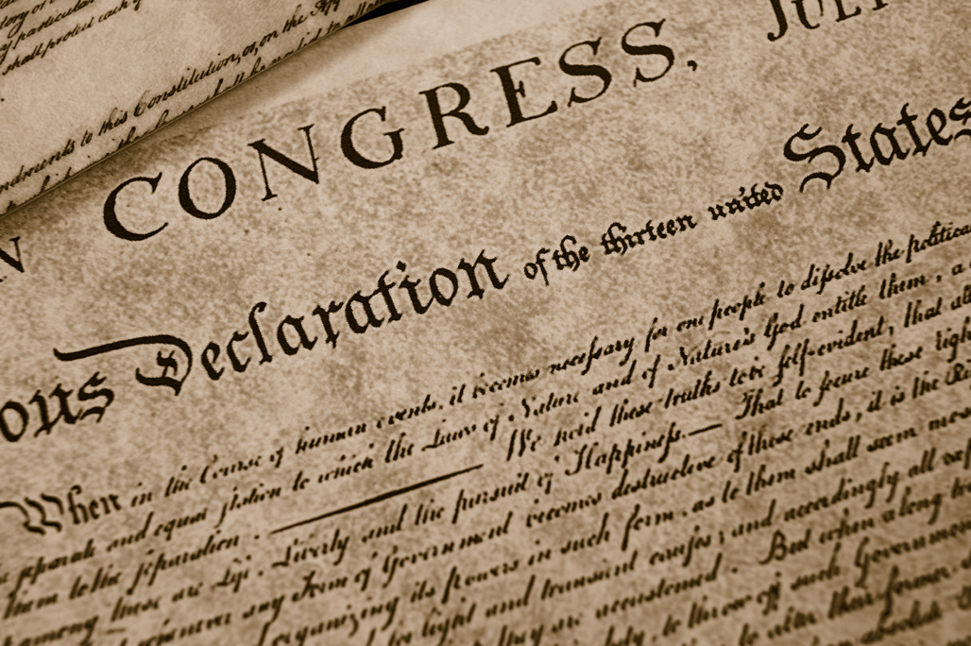
UNITED STATES DECLARATION OF INDEPENDENCE (1776)
In 1776, Thomas Jefferson penned the American Declaration of Independence which was approved by the United States Congress on July 4, 1776.

Slide 9
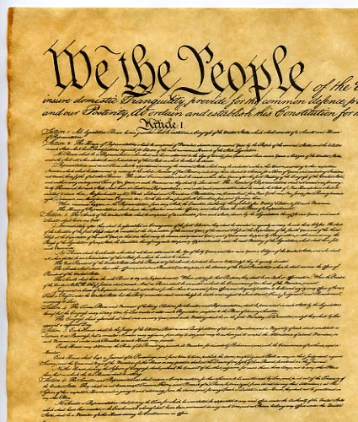
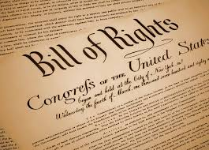
THE CONSTITUTION OF THE UNITED STATES OF AMERICA (1787) AND BILL OF RIGHTS (1791)

Slide 10
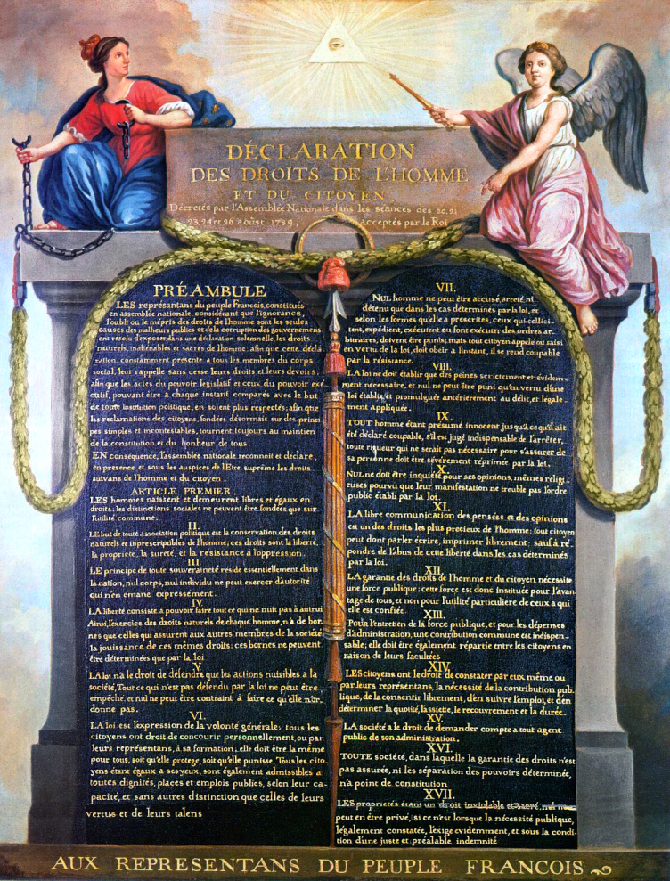
DECLARATION OF THE RIGHTS OF MAN AND OF THE CITIZEN (1789)
In 1789 the people of France brought about the abolishment of the absolute monarchy and the National Constituent Assembly adopted the Declaration of the Rights of Man and of the Citizen as the first step toward writing a constitution for the Republic of France.

Slide 11
THE FIRST GENEVA CONVENTION (1864)
In 1864, sixteen European countries and several American states attended a diplomatic conference in Geneva in order to provide for care to wounded soldiers.
THE UNITED NATIONS (1945)
Fifty nations met in San Francisco in 1945, after World War II, and formed the United Nations to protect and promote peace.

Slide 12
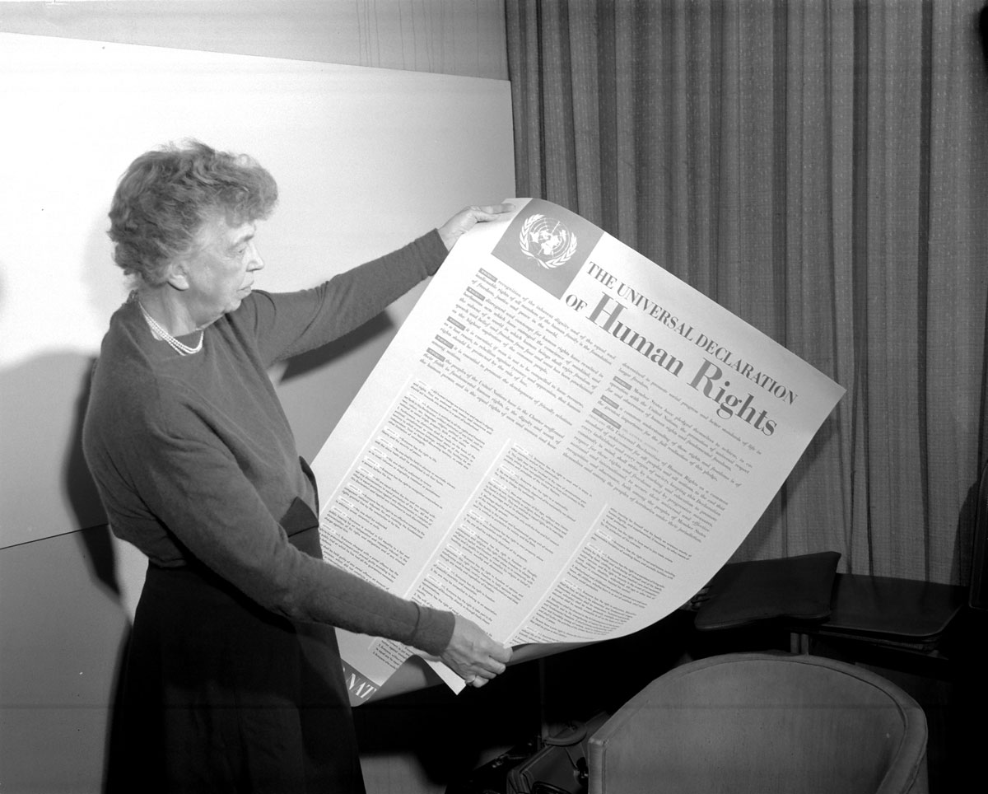
THE UNIVERSAL DECLARATION OF HUMAN RIGHTS (1948)
“All human beings are born free and equal in dignity and rights.”

Slide 13
THE CONSTITUTION OF THE ITALIAN REPUBLIC
On 2 June 1946, Italian people voted in favour of the referendum on the abolition of the monarchy and elected the Constituent Assembly by universal suffrage.
The Constitution of the Italian Republic was enacted by the Constituent Assembly on 22 December 1947, with 453 votes in favour and 62 against.

Slide 14
%
The Constitution is composed of 139 articles and arranged into three main parts:
It is followed by 18 Transitory and Final Provisions.
The Fundamental Principles (articles 1–12);
Part I concerning Rights and Duties of Citizens (articles 13–54);
Part II Organisation of the Republic (articles 55–139);

Slide 15
THE ITALIAN CONSTITUTION’S FUNDAMENTAL RIGHTS
RIGHT TO PERSONAL FREEDOM:
Article. 2 recognizes and guarantees the "inviolable rights of man, for the individual, and for social groups where personality is expressed”. All other rights and freedoms derive from the basic principle concerning personal freedom of both woman and man.

Slide 16
RIGHT OF LABOUR:
The Article 1 states that: "Italy is a democratic Republic, founded on labour". The right represents the central value of civil coexistence. It is the reason why the "Republic protects work in all its forms and applications” (Article 35), establishing the criteria for a correct remuneration which must be proportional to “to the quantity and quality of their work and in all cases sufficient to ensure them and their families a free and dignified existence” (Article 36).

Slide 17
The right is fundamental to protect workers from exploitation, as happened in factories during the Industrial Revolution, and to eliminate child labor. It is not a case that the article 32 of the Convention of the Rights of the Child recognizes “the right of the child to be protected from economic exploitation and from performing any work that is likely to be hazardous or to interfere with the child’s education, or to be harmful to the child’s health or physical, mental, spiritual, moral or social development”.
Oliver Twist(Charles Dickens)
Revealed: Industrial Revolution was powered by Child Slaves;
The work at the base of society is probably the consequence the American Dream, which derives from the Puritan work ethic and the Parable of the Talents.
The Reluctant Fundamentalist(Moshin Hamid): The fundamentals of work
Growing Up(Russell Wayne Baker)

Slide 18
THE RIGHT TO EQUALITY BETWEEN MEN AND WOMEN AT WORK:
Article 37 states that ”working women have the same rights and, for equal work, the same wages as working men”. The right has drawn inspiration from the RIGHT TO EQUALITY of all citizens. Thanks to article 37:
In Italy violence against women is abolished, such as the one suffered by Lispeth in the end of Kipling's short story;
Women can do all kinds of work without constraints (teacher and nurse) as happened in Russell Wayne Baker’s autobiography Growing Up;
Women cannot be dismissed from work for men and locked up in the home to perform their traditional tasks;
newspaper article published on the Independent

Slide 19
RIGHT TO EQUALITY :
Article 3 states that ”all citizens have equal social dignity and are equal before the law, without distinction as to sex, race, language, religion, political opinions, or personal or social condition”. However, very often people are conditioned by prejudices, making integration impossible.
The Reluctant Fundamentalist (Mohsin Hamid): Changez, who had been accepted until he broke the American rules of behavior and work;
Shame (Salman Rushdie): the immigrants and the newcomers who are often despised in nowadays’ society;
Lispeth (Rudyard Kipling): Lispeth was forced to adopt the English manners of behaviour;

Slide 20
RIGHT TO FAMILY:
Article 29 states that “The Republic recognizes the rights of the family as a natural association founded on matrimony. Matrimony is based on the moral and legal equality of the spouses within the limits laid down by law to guarantee the unity of the family”. Mutual respect can only be guaranteed by a marriage based on love and not on moral (getting married with someone you intend to dominate) and/or economic convenience:
Lispeth (Rudyard Kipling): Sonoo marriage;
Lispeth (Rudyard Kipling) and Revealed: Industrial Revolution was powered by Child Slaves published on the Independent: Lispeth and young people’s perception of marriage as an escape from their condition;

Slide 21
THE RIGHTS TO FOOD, EDUCATION (Article 34), HEALTH (Article 32) AND FREEDOM, AS WELL AS TO LIFE:
Although they are fundamental, in Asian, Pacific or African countries the aforementioned rights are still denied, especially to children, who are exploited to work. It is an extension of an already long-established practice common among the artisans and the farmers which became frequent during the Industrial Revolution. Reference texts for the subject matter are:
Child Labour Today;
Revealed: Industrial Revolution was powered by Child Slaves;
Oliver Twist (Charles Dickens);

Slide 22
RIGHT TO RELIGION:
Article 19 states that “All have the right to profess freely their own religious faith in whatever form, individual or collective, to propagate it and to exercise it in a private or public cult, provided that the rites are not contrary to public morals”. Therefore, the article proposes to eliminate the denial of the right to religion which occurred in the past as highlighted by Rudyard Kipling’s The White Man’s Burden, who were forced to convert to the Christian religion, and the condition of the Janissaries, Christian people adopted by Islamic families as a blood tax in order to become fighters. Prejudices about religion are also visible in The Reluctant Fundamentalist, when the protagonist is mocked for his religious faith or when he is advised not to show Muslim symbols such as a long beard, after the attack on the World Trade Centre.

Slide 23
RIGHT OF FREE ASSOCIATION:
Article 17 states that “Citizens have the right to assemble peaceably and unarmed. No previous notice is required for meetings, even when held in places open to the public”. The right legalizes the associations of workers that were illegal during the Industrial Revolution and even the ones of the children in Oliver Twist.
RIGHT TO JUSTICE (Article 32):

Slide 24
RIGHT TO VOTE:
It is recognized to all citizens, women and men, who have completed the 18th year of age. The vote must be personal, free and secret. Citizen participation in public life can be achieved both indirectly and directly. (Article 48)

