Slide 1
Morsut Giorgio 5ᵃQLSC 04\03\19 a.s. 2018\19
“Human Rights Background Knowledge and the Italian Constitution”

Slide 2
Table of contents
Declaration of Intention
What is a Human Right?
Historical phases of Human Rights’evolution
What is a Human Right violation?
Human Rights in the Italian Constitution
Connections between Human Rights and the texts we analyzed in class

Slide 3
Declaration of intention
This Power Point presentation has the aim to develop an individual path about Human Rights, through the creation of a logical connection between Human Rights present in the Italian Constitution and the texts we analyzed during our lessons.

Slide 4
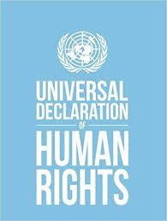
What is a HUMAN RIGHT?
According to the United Nations,we refer to Human Rights as “rights inherent to all human beings, regardless of race, sex, nationality, ethnicity, language, religion, or any other status.”
The most important Human Rights include right to: life,liberty,freedom from slavery and freedom of opinion and expression.
Human rights were set out for the first time in the “Universal Declaration of Human Rights” of 1948, a document that inspired the constitutions of many newly independent States and many new democracies.

Slide 5
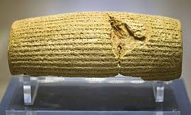
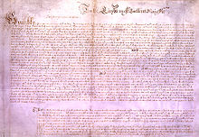
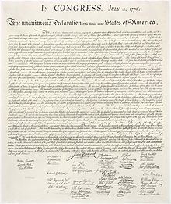
historical phases of human rights’evolution
1) Cyrus Cilinder 539 A.C
2) Magna Carta 1215
3) Petition of Right 1628
4) US declaration of Indipendence 1776
5) US Constitution 1787

Slide 6
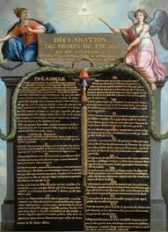
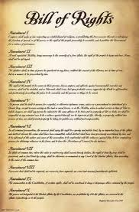
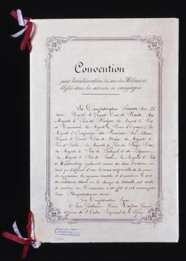
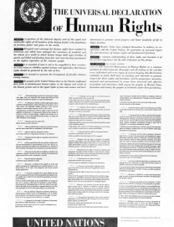
historical phases of human rights’evolution
6) Declaration of the Rights of the Men and the Citizens 1789.”
7) Bill of Rights 1791
8) The First Geneva Convention 1864
9) The United Nations 1945
10) The Universal Declaration of Human Rights 1948

Slide 7
What is a human right VIOLATION?
Even sixty years after the Universal Declaration of human Rights’ pubblication, human Rights are often violated in many countries of the World.
Since a violation can be seen as the act of break or fail to comply with a rule or formal agreement. A Human Right violation is the act of break or fail with an article of the Universal Declaration of Human Rights.
An Amnesty International’s research stated:
- Torture in at least 81 countries
- Unfair processes in at least 54 countries
- Limitations in the in the Freedom of expression in at least 77 countries
The third article of the Universal Declaration of human Rights says: "Everyone has the right to life, freedom and security of his person“. In the last years this article has been violated many times:
- 6.500 victims in armed conflicts in Afghanistan in 2007
- 1260 victims of the Police in Brasil in 2007
- Almost 500.000 victims in Refuge camps in Uganda, at least 1500 for week

Slide 8
HUMAN RIGHTS IN THE ITALIAN CONSTITUTION
After the 12 fundamental principles, the first part of the Constitution inserts 42 articles and it’s entitled “Rights and duties of the citizens”.
- Article 2 «The Republic recognises and guarantees inviolable human rights, both for the individual and within social groups where the individual’s personality is expressed, and it requires the fulfilment of the imperative duties of political, economic and social solidarity»
- Articles from 13 to 16 individual freedoms
- Articles from 17 to 21 collettive freedoms
- Articles from 22 to 28 limits in the use of strenght as self-defence
- Articles from 29 to 32 parents have the duty to educate their sons
- Articles 33 and 34 school and education have to be open for everyone
- Articles from 35 to 47 safeguard for each person of work, salary, emigration
- Articles from 48 to 54 political and economical Rights of the citizens,

Slide 9
CONNECTION BETWEEN HUMAN RIGHTS AND THE TEXTS WE ANALYZED IN CLASS
My individual path is focused on the violation of individual freedom.
It is peculiar to note how written material sometimes is put in a human Rights’ perspective, more specifically in the litterary text we analyzed in class it is important to note when individual freedoms are ignored.
An example is Mohsin Hamid’s “The Reluctant Fundamentalist” in which the post 9/11 Scenario pushes Americans to look with suspect at Muslims, badly influencing the freedom of somebody to profess his religion. In this case, there’s a violation of an article that deals with individual religious freedom.
Talking about religion, also in Kipling’s “Lispeth” the protagonist is forced to a religous conversion after their parents die of colera and she’s adopted by a Cristian family. This is another example of human’s Rights violation,again in a religious perspective.
Another important theme that deals with personal freedom’s violations is Children’s exploitation for work. About this, it is relevant an extract from Chapter 2 of Charles Dickens’ “Oliver Twist” titled “Oliver wants some more”. Dickens is really able, using irony and an hyperbolic language to create a grotesque atmosphere, with the aim to denounce the strict conditions in which they had to live and work. This is the third example of neglected individual freedom.

Slide 10
CONNECTION BETWEEN HUMAN RIGHTS AND THE TEXTS WE ANALYZED IN CLASS
Another text that deals with Children’s exploitation is an article written by David Keys and published in the “Indipendent”. According to Keys, Industrial Revolution was powered by child slaves. At that time England had over a million children workers, accounting for 15 per cent of the total labour force.
This terrible situation influenced very much parents’mentality in the following years, that sent their children to work more often,at a very young age.
In conclusion, I can state that in the texts I analyzed in class I noted some human Rights’violations that concerned individual freedoms. In particular, in a religious and working perspective.
Generally, I can say that religious and cultural human Rights are often violated in the collision between Western and Eastern worlds, as I red in “The Reluctant Fundamentalist” and in Salman Rushdie’s extract from his Novel “Shame”.
Moving on to Dickens, and Keys’ article, it is possible to create a parallelism between the two texts, both dealing with the theme of Children’s exploitation at the age of the Industrial Revolution, but becoming common also Nowadays, especially in Countries of the south-east Asia such as Vietnam and Hong-Kong.

Slide 11
SITOGRAPHY
In order of appearance:
www.un.org
www.marilenabeltramini.it
www.humanrights.com
www.integrazionemigranti.gov.it
it.wikipedia.org

