Slide 1

HUMAN RIGHTS
HOW CAN WE CONNECT THEM TO THE STUDIED TEXTS?
Giada Springolo 5QLSC a.s. 2018-2019

Slide 2

TABLE OF CONTENTS:
What Are Human Rights?
The Background of Human Rights
International Human Rights Law
Reference to studied literary texts

Slide 3
What Are Human Rights?
              HUMAN RIGHTS
Inherent to all human beings
They include:
the right to life and liberty
freedom from slavery and torture
freedom of opinion and expression
the right to work and education
And so on
Regardless of:
Race
Sex
Nationality
Ethnicity
Language
Religion
Any other status
Everyone is entitled to these rights, without discrimination

Slide 4
The Background of Human Rights
not the same modern-day conception of universal human rights
Ancient peoples
true forerunner of human-rights discourse: natural rights
17th century: John Locke discussed natural rights in his work
18th and 19th centuries: philosophers
universal and inalienable
"life, liberty, and estate (property)"
Thomas Paine
John Stuart Mill
Hegel
expanded on the theme of
universality

Slide 5
Baked-clay cilinder
Human rights inscribed in Akkadian language
Cyrus the Great :
THE CYRUS CYLINDER (539 B.C.)
Freed slaves
Declared the right to choose religion
Established racial equality
world’s first charter of human rights

Slide 6
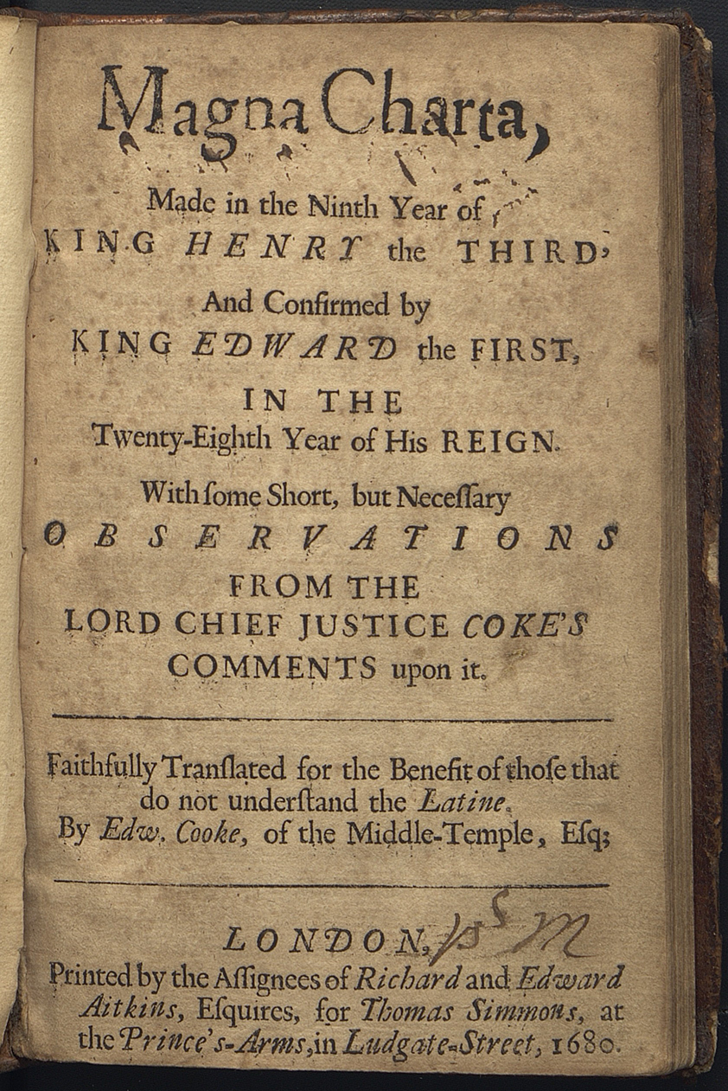
THE MAGNA CARTA (1215)
  Signed by the King of England
  Turning point in human rights
  One of the most important legal documents in the development of modern democracy
  Crucial turning point in the struggle to establish freedom.

Slide 7
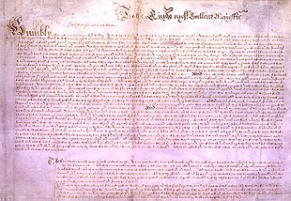
PETITION OF RIGHT: (1628)
Produced in 1628
By the English Parliament
Sent to Charles I as a statement of civil liberties
Based upon earlier statutes and charters
Asserted four principles:
No taxes may be levied without consent of Parliament
(2) No subject may be imprisoned without cause shown (reaffirmation of the right of habeas corpus)
(3) No soldiers may be quartered upon the citizenry
(4) Martial law may not be used in time of peace.

Slide 8
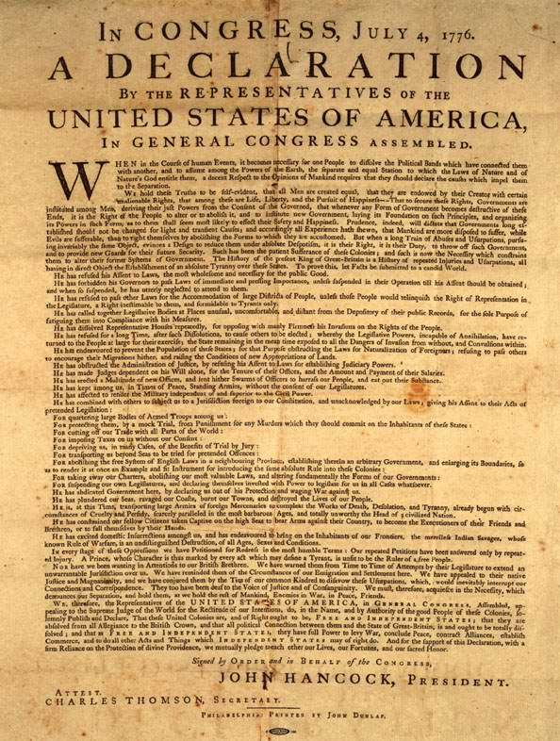
UNITED STATES DECLARATION OF INDEPENDENCE (1776)
WHO? Thomas Jefferson
WHEN? 4th July 1776
WHAT? Thirteen American Colonies were no longer a part of the British Empire.
WHERE? United States Congress
HOW? The declaration was first a formal explanation. Published as a printed broadsheet
widely distributed to the public

Slide 9
THE CONSTITUTION OF THE UNITED STATES OF AMERICA AND THE BILL OF RIGHTS
Written during the summer of 1787 in Philadelphia
Fundamental law of the US federal system of government
Landmark document of the Western world
Constitution of the United States of America
Bill of Rights
First ten amendments to the Constitution
15 December 1791
Protects freedom of speech, freedom of religion, the right to keep and bear arms, the freedom of assembly and the freedom to petition.

Slide 10
DECLARATION OF THE RIGHTS OF MAN AND OF THE CITIZENS (1789)
It proclaims that all citizens are to be guaranteed the rights of “liberty, property, security, and resistance to oppression.”

Slide 11
THE UNIVERSAL DECLARATION OF HUMAN RIGHTS (1948)
Eleanor Roosevelt, President Franklin Roosevelt’s widow
Adopted by the United Nations on December 10, 1948
“All human beings are born free and equal in dignity and rights.”

Slide 12
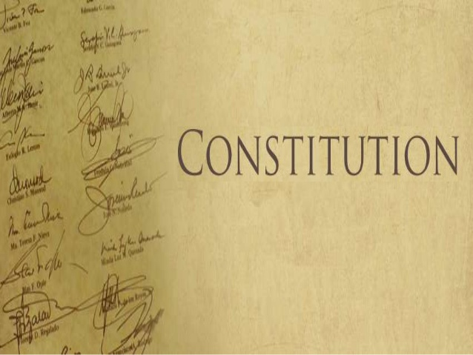
THE CONSTITUTION OF THE ITALIAN REPUBLIC
Constitution
Aggregate of fundamental principles or established precedents that constitute the legal basis of a polity, organization or other type of entity
The term constitution comes through French from the Latin word constitutio, used for regulations
It confers specific powers to an organization or institutional entity

Slide 13
Article 1:
1. Italy is a democratic Republic, founded on labour. Sovereignty belongs to the people, which exercises it in the forms and within the limits of the Constitution.
The Reluctant Fundamentalist
Growing up
Hard Times by Charles Dickens
IN LITERATURE

Slide 14
Article 3:
3. All citizens have equal social dignity and are equal before the law, without distinction as to sex, race, language, religion, political opinions, or personal or social condition. It is the duty of the Republic to remove those obstacles of an economic and social nature that, by in fact limiting the freedom and equality of citizens, impede the full development of the human person and the effective participation of all workers in the political, economic and social organisation of the country.
Lispeth
Growing up
The Reluctant Fundamentalist
IN LITERATURE

Slide 15
Article 4:
4. The Republic recognizes the right of all citizens to work and promotes those conditions that will make this right effective. Every citizen has the duty, according to capability and individual choice, to carry out an activity or a function that contributes to the material or spiritual progress of society
The Reluctant Fundamentalist
Growing up
Hard Times by Charles Dickens
What makes up a typical American?
Is America still puritan?
IN LITERATURE

Slide 16
Article 8:
8. All religious confessions are equally free before the law. Religious confessions other than Catholicism have the right to organise in accordance with their own statutes, in so far as they are not in conflict with Italian laws. Their relations with the State are regulated by law on the basis of agreement between the respective representatives.
Is America still Puritan?
What makes up a typical American?
The Reluctant Fundamentalist
IN LITERATURE

Slide 17
Article 10:
10. Italian laws conform to the generally recognized norms of international law. The legal status of foreigners is regulated by law in conformity with international norms and treaties. The foreigner who is denied in his own country the effective exercise of the democratic liberties guaranteed by the Italian Constitution has the right of asylum in the territory of the Republic, in accordance with the conditions established by law. A foreigner shall not be extradicted for political offences2
IN LITERATURE
The Reluctant Fundamentalist

Slide 18
Article 30:
30. It is the duty and right of parents to support, instruct and educate their children, even those born outside of matrimony. In case of the incapacity of the parents, the law provides for the fulfilment of their duties. The law ensures to children born outside of marriage full legal and social protection, compatible with the rights of members of the legitimate family. The law lays down the rules and limitations for ascertaining paternity
Lispeth
Hard Times
IN LITERATURE

Slide 19
Article 37:
37. Working women have the same rights and, for equal work, the same wages as working men. Working conditions must allow women to carry out their essential role in the family and ensure particular and adequate protection for the mother and the child. The law establishes the minimum age for paid labour. The Republic protects the work of minors by means of special provisions and, for equal work, guarantees them the right to equal pay
IN LITERATURE
Growing up
Oliver Twist

