Slide 1
Giacomo Veronico class V QLSC
Human Rights and the Italian Costitution

Slide 2
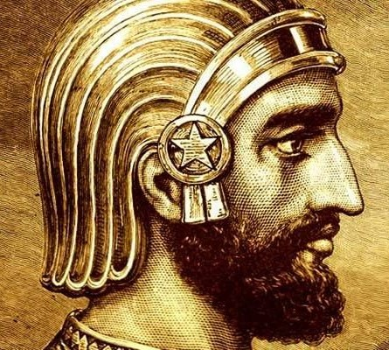
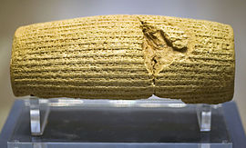
Human Rights
Background
In 539 b.C. Cyrus the Great freed the slaves and declared all the People can choose their own religion and established racial equality
The ancient record of his declaration is the Cyrus Cylinder.

Slide 3
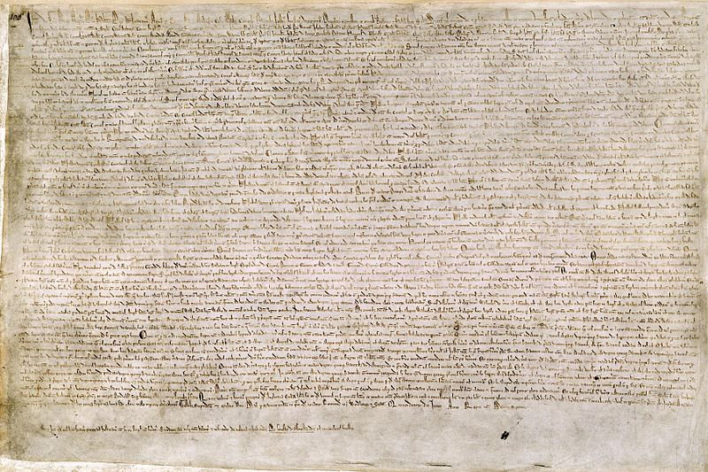
Background
There are several written precursors of today's human rights document.
The Magna Carta
Signed by King of England in 1215
It established :
Church's freedom from government
Free citizens can own a property
Widow can no remarry

Slide 4
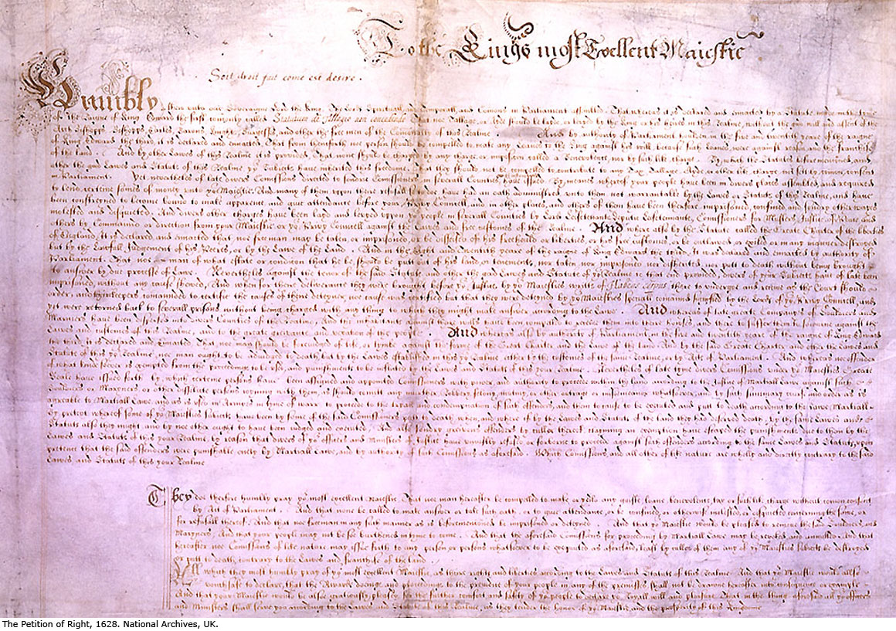
Petition of Rights
Sent by English Parliament in 1628:
taxes can't be levied without Parliament approval
Right of habeas corpus
Soldier do not be quartiered upon the citizenry
Martial law can not be used in time of peace.

Slide 5
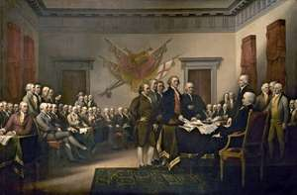
United States Indipendence
The Indipendence stressed two themes:
Individual rights
The right of revolution

Slide 6
The universal declaration of human rights
Adopted by 10 December 1948
In its preamble and in the Article 1, it proclaims the inherent right of all human beings.

Slide 7
The Italian Costitution
The Constituent Assembly in the session of 22 December 1947 approved the Constitution of the Italian Republic
Article 2 expresses the Italian State’s solemn acknowledgement of inviolable human rights
«The Republic recognises and guarantees inviolable human rights, both for the individual and within social groups where the individual’s personality is expressed, and it requires the fulfilment of the imperative duties of political, economic and social solidarity»

Slide 8
Principle of equality stated by article 3
All citizens have equal social dignity and are equal before thelaw, without distinction as to sex, race, language, religion, political opinions, or personal or social condition

Slide 9
The right to freedom of thought, conscience and religion
19. All have the right to profess freely their own religious faith in whatever form, individual or collective, to propagate it and to exerciseit in a private or public cult, provided that the rites are not contrary topublic morals.

Slide 10
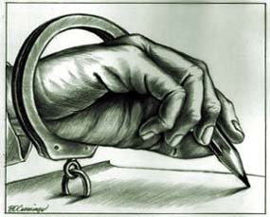
The right to freely manifest one’s thoughts
21. All have the right to express freely their own thoughts by word,in writing and by all other means of communication.The press cannot be subjected to authorisation or censorship

Slide 11
The right to education
30. It is the duty and right of parents to support, instruct aneducate their children, even those born outside of matrimony

Slide 12
Links with Literature
The right to education→ The Reluctant Fundamentalist by Mohsin Hamid
Principle of equality → Lispeth by Rudyard Kipling
→ Oliver Twist by Charles Dickens
Freedom of thought and religion → The Reluctant Fundamentalist by Mohsin Hamid

