Slide 1
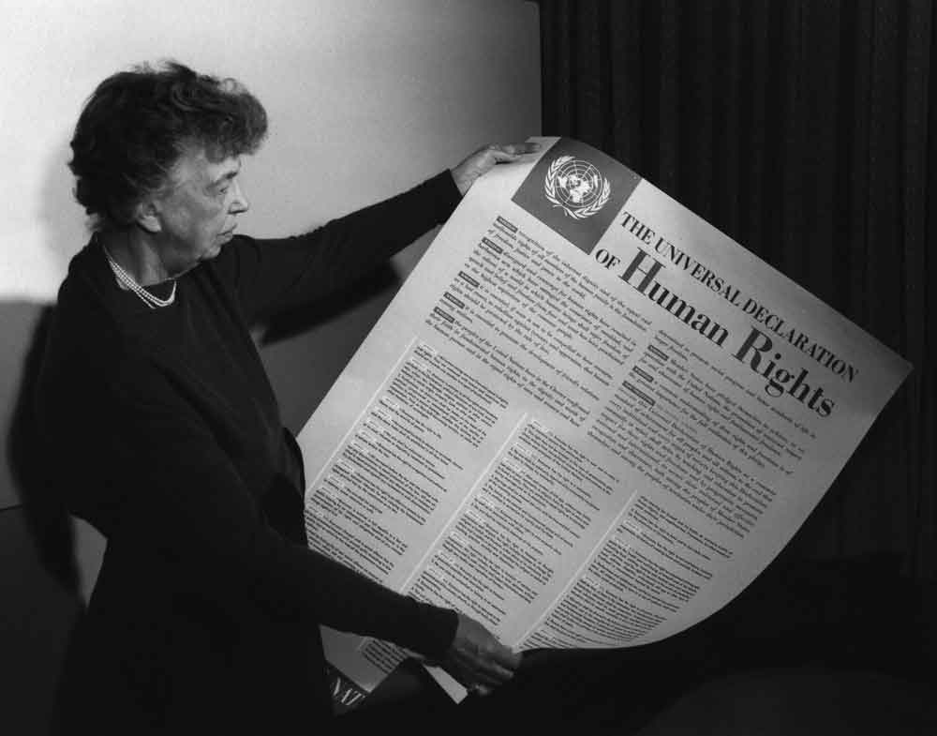
Human Rights
All human beings are born free and equal in dignity and rights. They are endowed with reason and coscience and should act towards one another in a spirit of brotherhood.
(Article 1, Universal Declaration of Human Rights)

Slide 2
Index
Introduction
How human rights are born?
The Constitution of the Italian Republic
Texts about human rights

Slide 3
Introduction
What are Human Rights?
They are fundamental rights that belong to every person, simply by being a human being.
Principles:
Universality
Equality
Non-discrimination

Slide 4
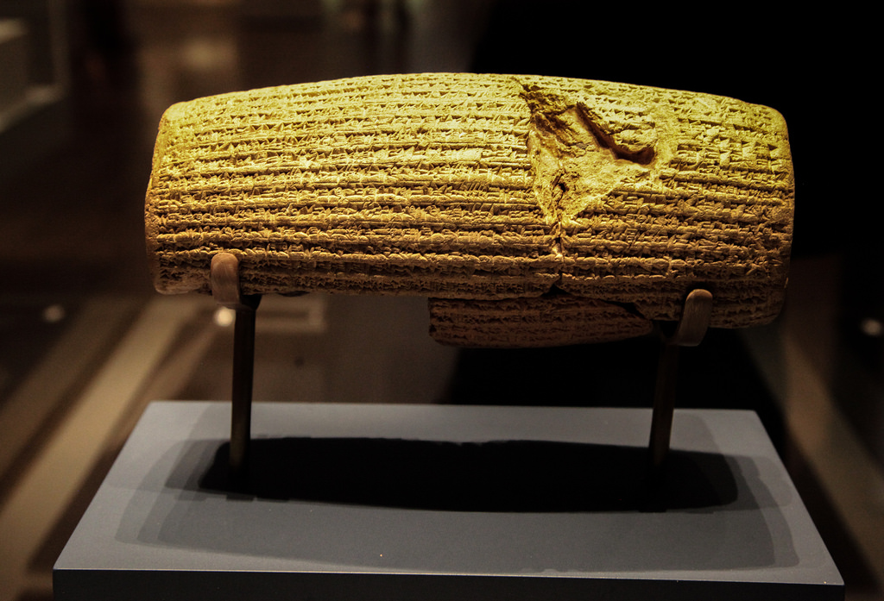
How human rights are born?
In 539 B.C., the armies of Cyrus the Great, the first king of ancient Persia, conquered the city of Babylon.
He freed the slaves, declared that all people had the right to choose their own religion, and established racial equality.
These and other decrees were recorded on a baked-clay cylinder in the Akkadian language with cuneiform script.
Known today as the Cyrus Cylinder, this ancient record has now been recognized as the world’s first charter of human rights.
Cyrus Cylinder

Slide 5
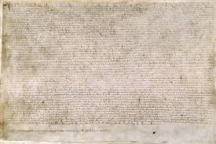
How human rights are born?
Magna Carta, or “Great Charter,” signed by the King of England in 1215, was a turning point in human rights.
The Magna Carta, or “Great Charter,” was arguably the most significant early influence on the extensive historical process that led to the rule of constitutional law today in the English-speaking world.
Magna Carta

Slide 6
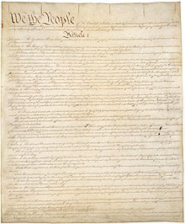
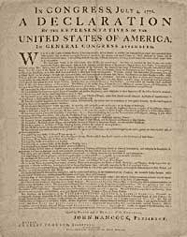
How Human Rights are born?
In 1776, Thomas Jefferson penned the American Declaration of Independence.
Philosophically, the Declaration stressed two themes: individual rights and the right of revolution.
The Constitution of the United States of America (1787) and Bill of Rights (1791)
The Bill of Rights of the US Constitution protects basic freedoms of United States citizens.

Slide 7
How Human Rights are born?
The United Nations
In April 1945, delegates from fifty countries met in San Francisco full of optimism and hope. The goal of the United Nations Conference on International Organization was to fashion an international body to promote peace and prevent future wars. The ideals of the organization were stated in the preamble to its proposed charter: “We the peoples of the United Nations are determined to save succeeding generations from the scourge of war, which twice in our lifetime has brought untold sorrow to mankind.”

Slide 8
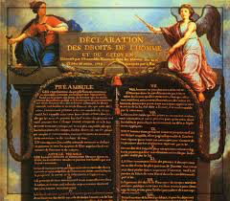
How Human Rights are born?
The Universal Declarationof Human Rights (UDHR) is a milestone document in the history of human rights.
The Declaration was proclaimed by the United Nations General Assembly in Paris on 10 December 1948 as a common standard of achievements for all people and all nations.
It sets out, for the first time, fundamental human rights tobe universally protected and it has been translated into over 500 languages.

Slide 9
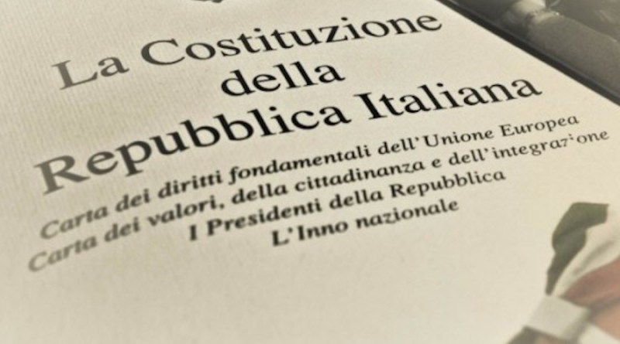
The Constitution of the Italian Republic
The Constitution of the Italian Republic is the act by which the fundamental principles of civil coexistence are established in democratic and republican Italy.
The Constitution is the consequence of the work of the first assembly elected by universal and direct suffrage, to which for the fisrt time, according to the decree of 1 February 1945, women were admitted.

Slide 10
The Constitution of the Italian Republic
Articles about Human Right:
Articles from 13 to 16 are about individual liberties
Articles from 17 to 21 are about collective liberties
From article 22 to 28 the principles and limits of the legitimate use of force are affirmed
From article 29 to 31 right and duty to educate and educate children

Slide 11
The Constitution of the Italian Republic
Article 32 states that the Republic protects health
Articles 33 and 34 affirm that art and science are free and free is their teaching
Articles 35 to 47 ensure labor protection and freedom of emigration
Articles from 48 to 54 declare political rights and duties

Slide 12
Texts about human rights
The Reluctant Fundamentalist by Mohsin Hamid
Growing up by Russel Wayne Baker
REFERRING TO THE TEXTS
Oliver Twist by Charles Dickens
Lispeth By Rudyard Kipling
The article about Child labour today

