Slide 1
HUMAN RIGHTS AND THE ITALIAN CONSTITUTION
ZOMERO MATTIA
5QLSC
ARTICLE 37. La donna lavoratrice ha gli stessi diritti e, a parità di lavoro, le stesse retribuzioni che spettano al lavoratore

Slide 2
TABLE OF CONTENTS
Motivation
What is a Human Right?
What is the violation of Human Rights?
The background of Human Rights
Connection between Human Rights and the texts we analyzed in class

Slide 3
Motivation
Know more about Human Rights
Find out their background
Consider if they are respected
Reference with studied texts

Slide 4
What is a Human Right?
Human rights = the rights granted you by the simple fact of being a human
Rights = freedom granted
Human = member homo sapiens

Slide 5
What is a Human Right?
Principles
Universality
Equality
Non-discrimination
Freedom

Slide 6
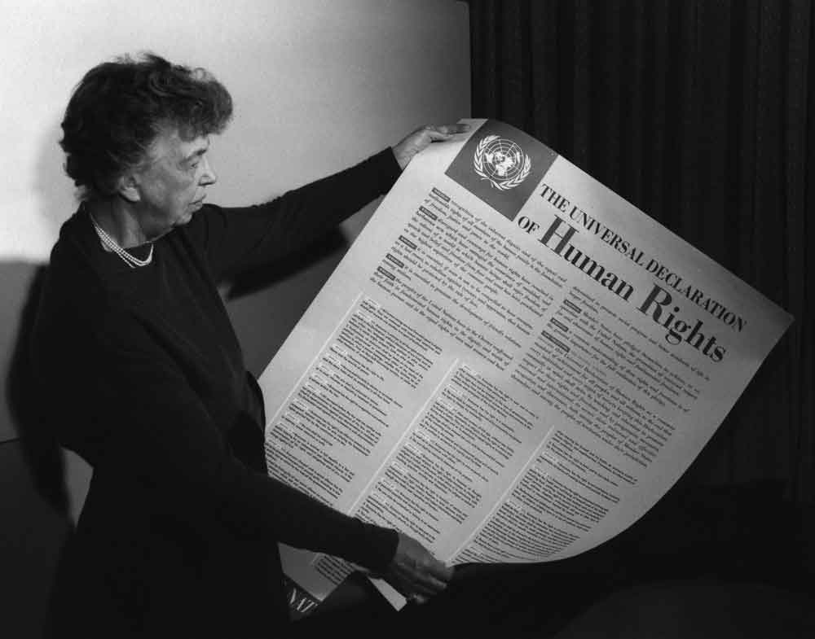
Background of Human Rights
The Cyrus Cylinder (539 B.C.)
The Magna Carta (1215)
Petition of Right (1628)
The Constitution of the United States of America (1787) and Bill of Rights (1791)
The Universal Declaration of Human Rights (1948)

Slide 7
Constitution of the Italian Republic
Dicember 22nd 1947: the Italian Constitution was written and approved by the Constituent Assembly
It represents the act by which the fundamental principles of civil coexistence are established in democratic and republican Italy.

Slide 8
Constitution of the Italian Republic
Values
Freedom of thought
Freedom of religion
Right to work
Right to education
Respect
Right for immigrants
Right to health
Equality

Slide 9
Violation of Human Rights
Freedom of though
Freedom of movement
Freedom of expression
Torture
Slavery
Amnesty 2015 ranking.
1)Angola
2)Arabia Saudita
3)Burundi
4)Cina
5)Egitto

Slide 10
Violation of Human Rights
ARTICLE 37. La donna lavoratrice ha gli stessi diritti e, a parità di lavoro, le stesse retribuzioni che spettano al lavoratore
⬇
It is not respected because there is a wage gap
A recent United Nation study showed that women earn 23% less than men

Slide 11
Reference with studied texts
Growing up
women do not have the same opportunities as men
Lispeth
Lispeth was supposed to become nothing more than a nurse or “something genteel”; she was meant to marry someone with her same origins.
Doris was expected to be a wife, a mother, or something like a nurse or a teacher.

