Slide 1
HUMAN RIGHTS
“To deny people their human rights is to
challenge their very humanity”
Nelson Mandela
Rocco Gregori 5QLSC 2018-2019

Slide 2
INDEX:
What are Human Rights?
History of Human Rights
Recognition of Human Rights in theItalian Constitution
Texts related to Human Rights

Slide 3
What are Human Rights?
Human rights are the basic rights and freedoms that belong to every person in the world, from birth until death
Inalienable
Indivisible
Depending on each other
To violate someone’s human rights is to treat that person as though she or he were not a human being

Slide 4
History of Human Rights
539 B.C -The Cyrus Cylinder
1215 - The Magna Carta
1628 -The Petition of Rights
1776 – United States Declaration of Indipendence

Slide 5
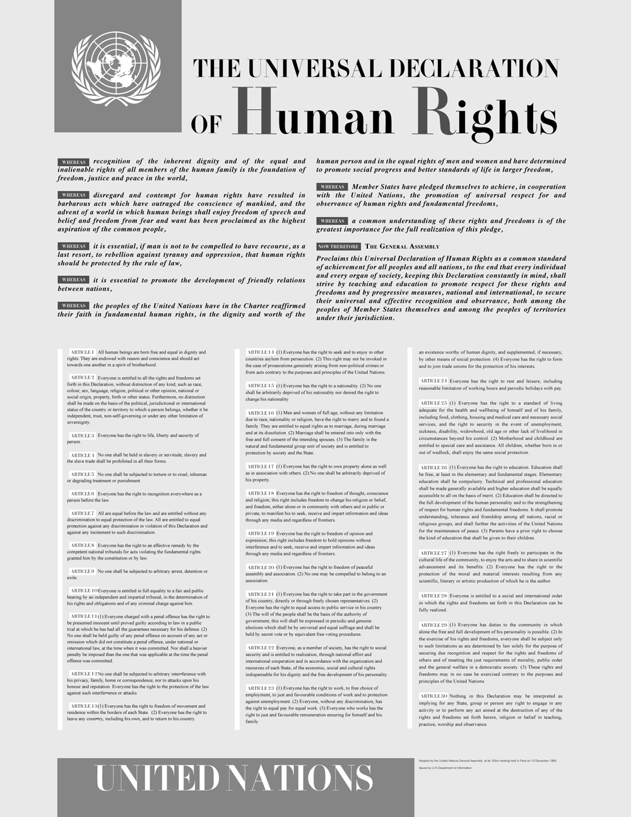
History of Human Rights
The Birth of the United Nations
10 December 1948 Universal
Declaration of Human Rights
Its principles have been incorporated into the constitutions of most of the more than 185 nations now in the United Nations
Articles 1-2 established the basic concepts of dignity,liberty,equality and brotherhood
Articles 3-5 established other individual rights, such as the rights to life and the prohibition of slavery and torture
Articles 6-11 refer to the fundamental legality of human rights with specific remedies cited for their defence when violated
Articles 12-17 established the rights of the individual towards th community
Articles 18-21 sanctioned the “constitutional liberties”, and with spiritual, public and political freedoms, such as freedom of thought, opinion, religion and conscience, word and peaceful association of the individual
Articles 22-27 sanctioned an individual’s economic, social and cultural rights, including healthcare
Articles 28-30 established the general ways of using these rights, the areas in which these rights cannot be applied and that they cannot be overcome against the individual

Slide 6
Recognition of Human Rights in the Italian Constitution
Art. 2. «The Republic recognises and guarantees inviolable human rights, both for the individual and within social groups where the individual’s personality is expressed, and it requires the fulfilment of the imperative duties of political, economic and social solidarity»
Art.3 .“All citizens have equal social dignity and are equal before the law, without distinction of sex, race, language, religion, political opinion, personal and social conditions. It is the duty of the Republic to remove those obstacles of an economic or social nature which constrain the freedom and equality of citizens, thereby impeding the full development of the human person and the effective participation of all workers in the political, economic and social organization of the country. “
Art. 13. “Personal liberty is inviolable. No one may be detained, inspected, or searched nor otherwise subjected to any restriction of personal liberty except by order of the Judiciary stating a reason and only in such cases and in such manner as provided by the law”
Art.14. “The home is inviolable. Personal domicile shall be inviolable. Home inspections, searches, or seizures shall not be admissible save in the cases and manners complying with measures to safeguard personal liberty. Controls and inspections for reason of public health and safety, or for economic and fiscal purposes, shall be regulated by appropriate laws.”

Slide 7
Recognition of Human Rights in the Italian Constitution
Art.19. “Anyone is entitled to freely profess their religious belief in any form, individually or with others, and to promote them and celebrate rites in public or in private, provided they are not offensive to public morality.”
Art.22. “No-one may be deprived of his legal capacity, citizenship, or name for political reasons.”
Art.30. “It is the duty and right of parents to support, raise and educate their children, even if born out of wedlock. In the case of incapacity of the parents, the law provides for the fulfilment of their duties. The law ensures such legal and social protection measures as are compatible with the rights of the members of the legitimate family to any children born out of wedlock. The law shall establish rules and constraints for the determination of paternity.”
Art.35. “The Republic protects work in all its forms and practices. It provides for the training and professional advancement of workers. It promotes and encourages international agreements and organisations which have the aim of establishing and regulating labour rights. It recognises the freedom to emigrate, subject to the obligations set out by law in the general interest, and protects Italian workers abroad. ”

Slide 8
Texts related to Human Rights
The Reluctant Fundamentalist (Moshin Hamid)
Right engaged: Art.2 UDHR “Everyone is entitled to all the rights and freedoms set forth in this Declaration, without distinction of any kind, such as race, colour, sex, language, religion, political or other opinion, national or social origin, property, birth or other status. Furthermore, no distinction shall be made on the basis of the political, jurisdictional or international status of the country or territory to which a person belongs, whether it be independent, trust, non-self-governing or under any other limitation of sovereignty.”
The right is in conflict People glared at Changez
due to his beard.
He came back to Pakistan

Slide 9
Texts related to Human Rights
The Reluctant Fundamentalist (Moshin Hamid)
Right engaged: Art.3 UDHR “Everyone has the right to life, liberty and security of person”
The right is in conflict: - Terrorism (9/11);
- Changez learns that Pakistan might soon go
to war with India soon;

Slide 10
Texts related to Human Rights
Oliver Twist ,Chapter 2 “Oliver wants some more”
(Charles Dickens)
Rights Engaged: Art 4.UDHR “No one shall be held in slavery or servitude; slavery and the slave trade shall be prohibited in all their forms.”
Art.7 UDHR “All are equal before the law and are entitled without any discrimination to equal protection of the law. All are entitled to equal protection against any discrimination in violation of this Declaration and against any incitement to such discrimination.”

Slide 11
Texts related to Human Rights
Oliver Twist ,Chapter 2 “Oliver wants some more”
(Charles Dickens)
The Rights are denied: -Children are starving
-Difference between the Master and the
children
-Children are treated as if they were slaves

