Slide 1
HUMAN RIGHTS and ITALIAN CONSTITUTION
Poian Sara
5QLSC
Liceo scientifico A. Einstein
A.S. 2018/2019

Slide 2
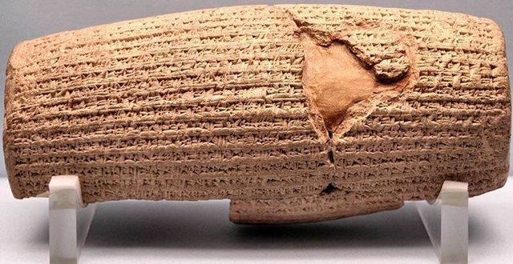
The backgroud of the human rights
The Cyrus Cylinder (539 B.C.)
In 539 B.C., the armies of Cyrus the Great, the first king of ancient Persia, conquered the city of Babylon.
→ He freed the slaves, declared that all people had the right to choose their own religion, and established racial equality.
These and other decrees were recorded on a baked-clay cylinder, known today as the Cyrus Cylinder, in the Akkadian language with cuneiform script.
It is the world’s first charter of human rights

Slide 3
The Spread of Human Rights
Babylon India Greece Rome
“Natural law”
people tended to follow certain unwritten laws in the course of life, and Roman law was based on rational ideas derived from the nature of things.
Documents asserting individual rights, such as the Magna Carta (1215), the Petition of Right (1628), the US Constitution (1787), the French Declaration of the Rights of Man and of the Citizen (1789), and the US Bill of Rights (1791) are the written precursors to many of today’s human rights documents.

Slide 4
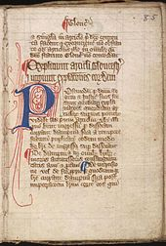
The Magna Carta (1215)
The Magna Carta, or “Great Charter,” was arguably the most significant early influence on the extensive historical process that led to the rule of constitutional law today in the English-speaking world.
1215 - King John of England violated a number of ancient laws and customs by which England had been governed → his subjects forced him to sign the Magna Carta, which enumerates the human rights
the right of the church to be free from governmental interference;
the rights of all free citizens to own and inherit property and to be protected from excessive taxes;
the right of widows who owned property to choose not to remarry.
crucial turning point in the struggle
to establish freedom

Slide 5
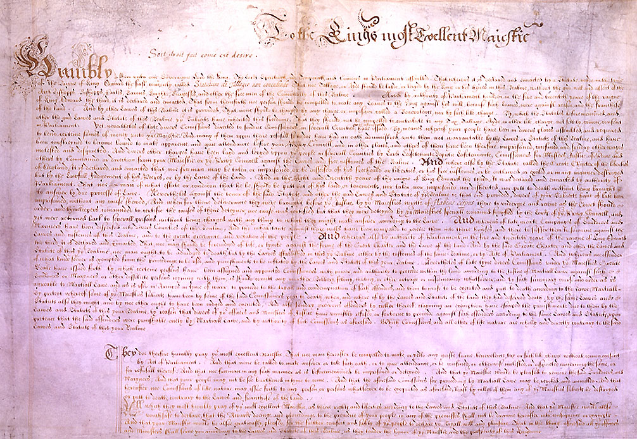
Petition of Right (1628)
In 1628 the English Parliament sent this statement of civil liberties to King Charles I
Refusal by Parliament to finance the king’s unpopular foreign policy had caused his government to exact forced loans and to quarter troops in subjects’ houses as an economy measure
→ initiated by Sir Edward Coke, was based upon earlier statutes and charters
four principles:
no taxes may be levied without consent of Parliament;
no subject may be imprisoned without cause shown;
no soldiers may be quartered upon the citizenry;
martial law may not be used in time of peace

Slide 6
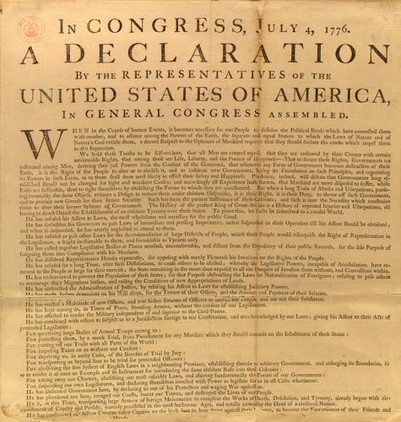
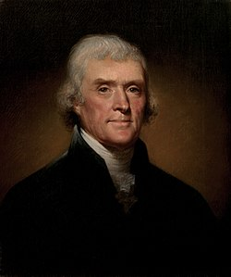
United States Declaration of Independence (1776)
On July 4, 1776, the United States Congress approved the Declaration of Independence. Its primary author, Thomas Jefferson, wrote the Declaration as a formal explanation of why Congress had voted on July 2 to declare independence from Great Britain
Congress issued the Declaration of Independence in several forms - it was initially published as a printed broadsheet
Philosophically, the Declaration stressed two themes: individual rights and the right of revolution

Slide 7
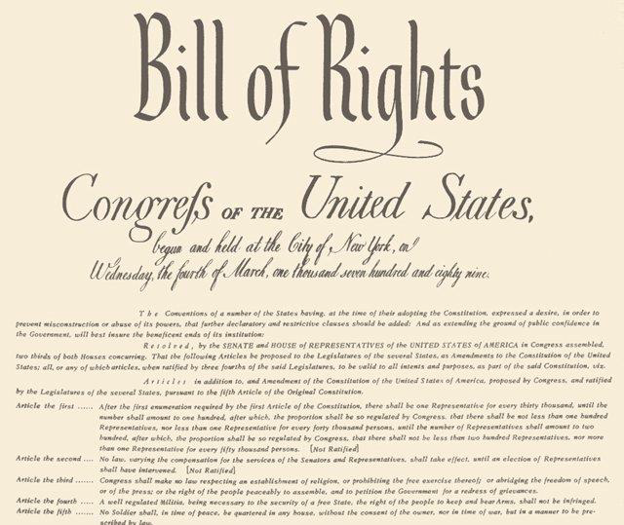
The Constitution of the United States of America (1787) and Bill of Rights (1791)
Written during the summer of 1787 in Philadelphia, the Constitution of the United States of America is the fundamental law of the US federal system of government and the landmark document of the Western world
protects basic freedoms of United States citizens
It is the oldest written national constitution in use and defines the principal organs of government and their jurisdictions and the basic rights of citizens economy measure

Slide 8
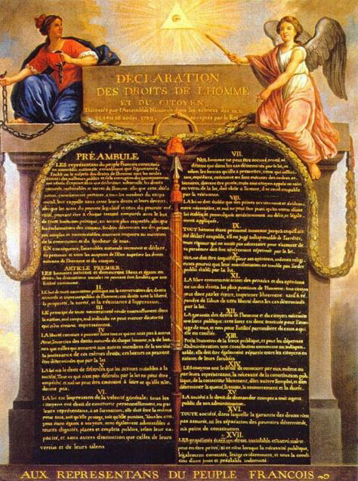
Declaration of the Rights of Man and of the Citizen (1789)
1789 - abolition of the absolute monarchy
the Declaration of the Rights of Man and of the Citizen was adopted by the National Constituent Assembly as the first step toward writing a constitution for the Republic of France
all citizens are to be guaranteed the rights of “liberty, property, security, and resistance to oppression”
the Declaration sees law as an “expression of the general will”
- equality of rights
- forbid “only actions harmful to the society”

Slide 9
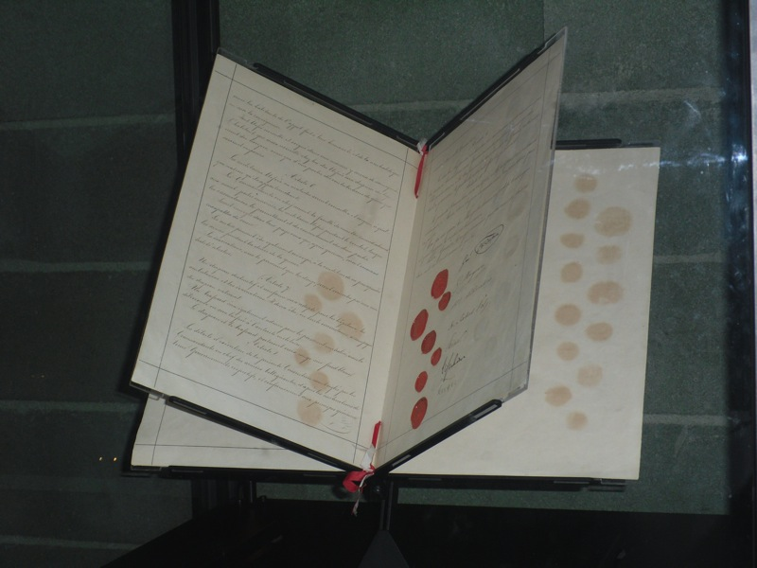
The First Ginevra Convention (1864)
1864 - sixteen European countries and several American states attended a conference in Geneva
Purpose: adopting a convention for the treatment of wounded soldiers in combat
main principles: obligation to extend care without discrimination to wounded and sick military personnel and respect for and marking of medical personnel transports and equipment with the distinctive sign of the red cross on a white background.

Slide 10
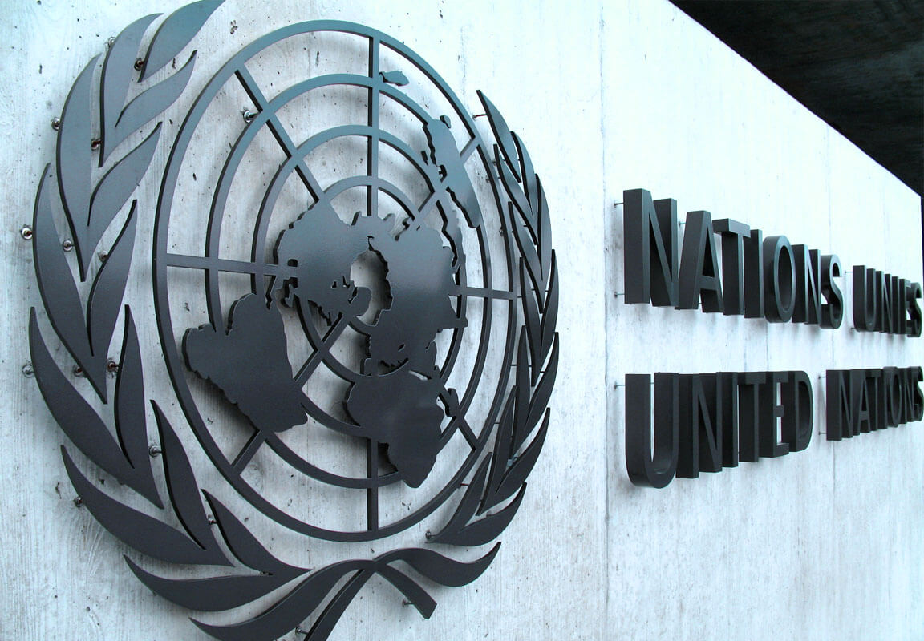
The United Nations (1945)
Fifty nations met in San Francisco in 1945 and formed the United Nations to protect and promote peace after the World War II
The goal of the United Nations Conference on International Organization was to fashion an international body to prevent future wars
The Charter of the new United Nations organization went into effect on October 24, 1945, a date that is celebrated each year as United Nations Day

Slide 11
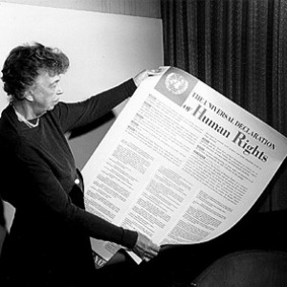
The Universal Declaration of Human Rights (1948)
Under the dynamic chairmanship of Eleanor Roosevelt - President Franklin Roosevelt’s widow, a human rights champion in her own right and the United States delegate to the UN - the Commission set out to draft the document that became the Universal Declaration of Human Rights
Article 1 and its preamble - inherent rights of all human beings - :
“All human beings are born free and equal in dignity and rights.”
thirty Articles of human rights that, for the first time in history, had been assembled and codified into a single document
In consequence, many of these rights, in various forms, are today part of the constitutional laws of democratic nations
The Declaration was considered as the international Magna Carta for all mankind;
It has been adopted by the United Nations on December 10, 1948

Slide 12
The Constitution is the fundamental law of a legal system and it provides the basis of legitimacy for all sources of law and activities by the public authority
Dicember 22nd 1947: the Italian Constitution was written and approved by the Constituent Assembly
It was elected by universal suffrage – 2° June 1946 – after the end both of fascism and the WW II
the Constitution of the Italian republic represents the act by which the fundamental principles of civil coexistence are established in democratic and republican Italy
139 articles
Four sections: fundamental principles, “Rights and Duties of Citizens”, “Organization of the Republic”, 18 transitional and final provisions

Slide 13
Fundamental rights
Article 2
«The Republic recognizes and guarantees inviolable human rights, both for the individual and within social groups where the individual’s personality is expressed, and it requires the fulfillment of the imperative duties of political, economic and social solidarity» (article 2 of the Italian Constitution)
Article 2 expresses the Italian State’s solemn acknowledgement of inviolable human rights. This article states the principle according to which even the sovereign power must stop in front of the individual’s rights.
Article 3
All citizens have equal social dignity and are equal before the law, without distinction as to sex, race, language, religion, political opinions, or personal or social condition.

Slide 14
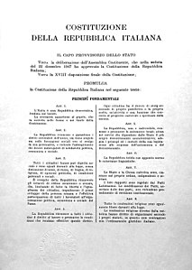
Article 10
Italian laws conform to the generally recognized norms of international law.
The legal status of foreigners is regulated by law in conformity with international norms and treaties.
The foreigner who is denied in his own country the effective exercise of the democratic liberties guaranteed by the Italian Constitution has the right of asylum in the territory of the Republic, in accordance with the conditions established by law.
A foreigner shall not be extradicted for political offences .

Slide 15
the right to life
the right not to suffer any cruel, inhuman, degrading sentences, treatments or punishments
the right not to be reduced into slavery or to be obliged to forced labour
the right to freedom and personal safety, except in the case of arrest and legitimate imprisonment
the right of action in order to protect one’s rights in civil, penal and administrative matters in front of an independent judge and pre-established by law and in reasonable times
the right to the respect for private and family life, for one’s own domicile and correspondence, without any interference which is not provided for by law
the right to freely manifest one’s thoughts
the right to freedom of thought, conscience and religion, including the freedom to change religion or thought, and the freedom to manifest one’s religion or thought in private or in public
the right to the respect for legality within the penal ambit, that is the prohibition to sentence someone for an action that does not constitute crime
the right to freedom of pacific meetings and freedom of association, including the right to establish trade unions and become trade union members for the defence of one’s interests
the right to marry and form a family, within which the spouses have the same rights and responsibilities toward each other and toward their children
the right to education
the right to health

Slide 16
Referring to the texts analyzed
Rights and Duties of the Citizens – title I Civil Rights
16. All citizens may travel or sojourn freely in any part of the national territory, subject to general limitations that the law establishes for reasons of health and safety. No restrictions may be imposed for political reasons.
All citizens are free to leave and to re-enter the territory of the Republic, subject to legal duties.
The Reluctant Fundamentalist, Mohsin Hamid – Changez
About Movers, Salman Rushdie
Lispeth, Rudyard Kipling

Slide 17
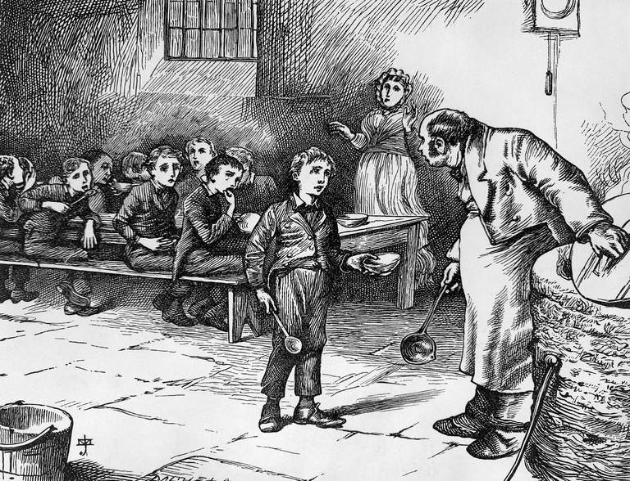
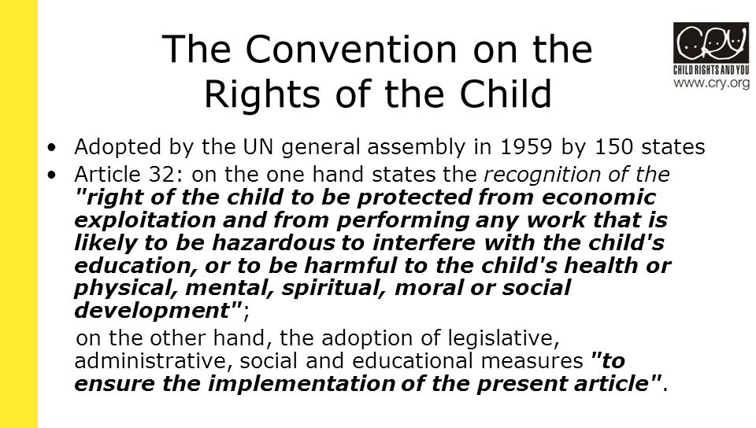
Referring to the texts analyzed
Question of child labour
workhouses
Industrial Revolution was powered by child slaves, Jane Humphries
Child Labour Today
Oliver Twist, Oliver Wants Some More, Charles Dickens

Slide 18
Referring to the texts analyzed
Rights and Duties of the Citizens – title I Civil Rights
19. All have the right to profess freely their own religious faith in whatever form, individual or collective, to propagate it and to exercise it in a private or public cult, provided that the rites are not contrary to public morals.
from Puritans
expelled from England in the 17th century – they travelled to North America
they dissenters the authority of the Church of England and believed that it needed to be spiritually purified

Slide 19
Referring to the texts analyzed
Rights and Duties of the Citizens – title III Economic Relations
37. Working women have the same rights and, for equal work, the same wages as working men. Working conditions must allow women to carry out their essential role in the family and ensure particular and adequate protection for the mother and the child.
The law establishes the minimum age for paid labour.
The Republic protects the work of minors by means of special provisions and, for equal work, guarantees them the right to equal pay.
from “Growing Up”, The American Dream, Russell Wayne Baker
American contradiction
Women and men had not the same opportunities

Slide 20
INDUSTRIAL REVOLUTION
The history of the United States is closely related to the history of Puritans
They believed that God wanted them to live following the Scriptures; they strongly believed in predestination and viewed success as a sign of salvation as well
The Puritans left a strong legacy of values – extremely important for the US
PARABLE
Yankee work ethic
Man’s work is done primarily for God
TALENTS
of
the
Achievement
and individualism
Everybod is given the chance to HAVE SUCCESS
IDEA of PROGRESS

Slide 21
PARABLE OF THE TALENTS
God gives talents to people, everybody has to use talents correctly
He who is able to produce goods and wealth will improve his/her social condition and he/she will reaches God’s blessing
Puritanism based on the idea of the increase of wealth
laid the foundations of consumerism in US
America became one of the most important world power
It is linked to the
PRINCIPLE of UTILITY
To produce benefits, advantage, pleasure in order to prevent the happening of pain, evil
INDUSTRIAL REVOLUTION
The title ‘Growing Up’ suggests an economic and social growth
THE DREAM → to get always new achievements development
~ The Reluctant Fundamentalist

Slide 22
The passage, The American Dream, taken from ‘Growing Up’ is about the separation of roles in 1930s America
“Doris could have made something of herself is she hadn’t been a girl. Because of this defect, however, the best she could hope for was a career as a nurse or a school teacher, the only work that capable females were considered up to in those days.”
Message between the lines: women had not the same opportunities as men.
“Fifty years ago parents still asked boys if they wanted anyone to grow up to be President. […] Abraham Lincoln had done it.”
Importance of memory – A. Lincoln represents the symbol of freedom

Slide 23
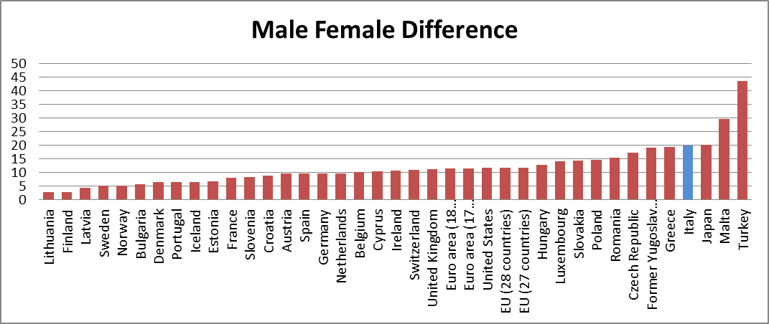
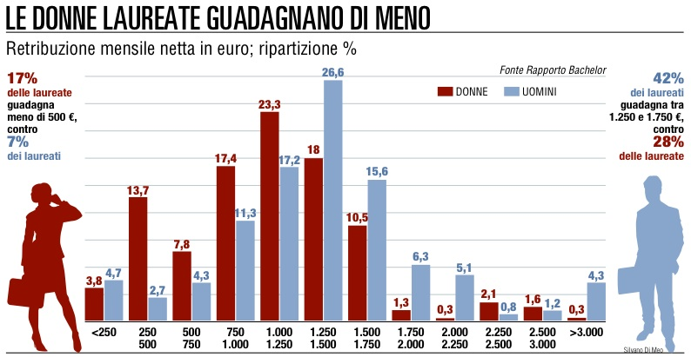

Slide 24
Nowadays…
The condition of Muslim women is still problematic:
they still have to face the authority of the father, brothers, husband;
their body is "a cause of shame" and therefore should be veiled
In traditionalist countries women are even deprived of fundamental human and civil rights: they do not enjoy freedom of movement, freedom of expression and speech; they cannot proceed in their studies or even make a career or hold positions or positions of responsibility in the civil or religious field. They cannot decide their own destiny or that of their children and they are totally submissive to man.
The road to the equality of sexes is long and tricky
However, the progress made in the western world gives us hope that one day women can finally have the same human rights throughout the world.

Slide 25
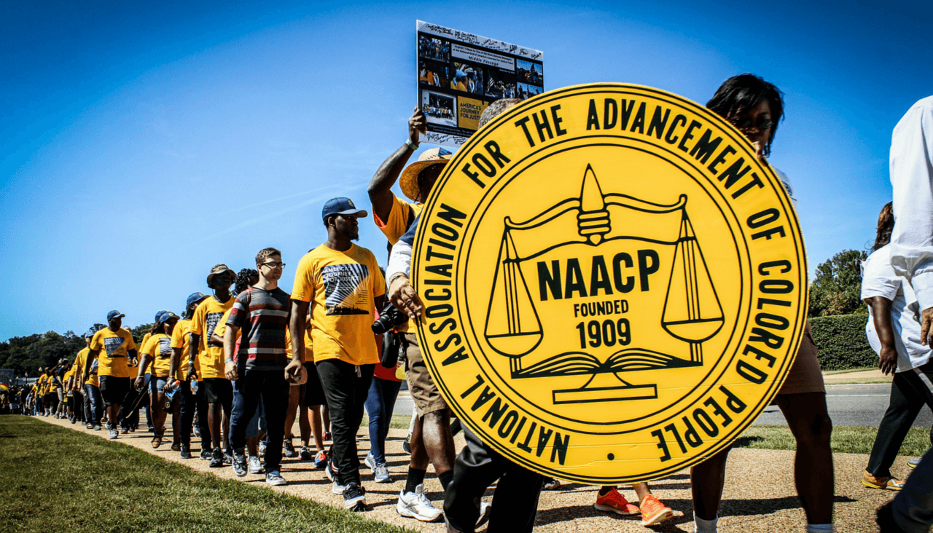
Organizations that defend human rights

