Slide 1
CHILD EXPLOITATION

Slide 2
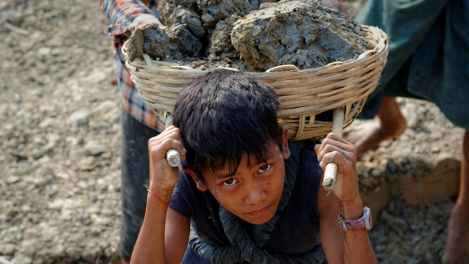
Introduction
The term «child labour» refers to
work that deprives children of their childhood, their potential and their dignity,
It is harmful to their physical and mental development.
It interferes with their schooling by depriving them of the opportunity to attend school or obli ging them to leave schol prematurely.

Slide 3
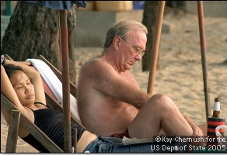
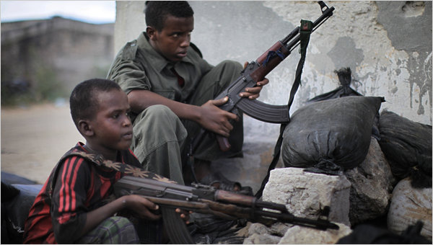
VARIOUS FORMS OF CHILD ABUSE
  Emotional abuse: refers to the psychological and social aspects of child abuse.
  Pshysical abuse: hitting, slapping, or striking etc. with an object refers to physical abuse.
  Sexual abuse: describes any incident in which a chld is coerced into sexual activity by another child or an adult.
  Family violence: family violence usually refers to the physical assault of children and women by male relatives, usually a father and husand/partner.
  Organised sexual abuse: organised sexual abuse refers to the range of circumstances in which multiple children are subject to sexual abuse by multiple perpetrators.
  Armoured abuse: refers to the guns and armour to child for self profit which makes a child terrorist.

Slide 4
RIGHT AGAINST EXPLOITATION
Child Labour violates Article no. 32 of Convention on the Rights of the Child (CRC)
⇩
It states the child’s right
“to be protected from economic exploitation and from performing any work that is likely to be hazardous or to interfere with the child’s education, or to be harmful to the child’s health or physical, mental, spiritual, moral or social development.”
Apart from this, depending on the type of occupation it may violate the following articles of CRC :
(i) Article 6 - Right to ‘development of a child’ to ‘maximum extent possible’.
(ii) Article 18 - Right to protection from all forms of ‘maltreatment or exploitation’.
(iii) Article 24 - Right to proper ‘healthcare’.
(iv) Article 28 - Right to ‘education’.
(v) Article 31 - Right to ‘rest and leisure’ or to ‘engage in play and recreational activities’.

Slide 5
Child labour today: 10 facts
1) Worldwide 218 million children between 5 and 17 years are in employment; 152 million are victims of child labour.
2) Almost half of them, 73 million, work in hazardous child labour.
3) Hazardous child labour is most prevalent among the 15-17 years old.
4) Nevertheless up to a fourth of all hazardous child labour (19 million) is done by children less than 12 years old.
5) In absolute terms, almost half of child labour (72.1 million) is to be found in Africa; 62.1 million in Asia and the Pacific; 10.7 million in the Americas; 1.2 million in the Arab States and 5.5 million in Europe and Central Asia.
6) In terms of prevalence, 1 in 5 children in Africa (19.6%) are in child labour, whilst prevalence in other regions is between 3% and 7%: 2.9% in the Arab States (1 in 35 children); 4.1% in Europe and Central Asia (1 in 25); 5.3% in the Americas (1 in 19) and 7.4% in Asia and the Pacific region (1 in 14).
7) Almost half of all 152 million children victims of child labour are aged 5-11 years; 42 million (28%) are 12-14 years old; and 37 million (24%) are 15-17 years old.
8) Among 152 million children in child labour, 88 million are boys and 64 million are girls.
9) 58% of all children in child labour and 62% of all children in hazardous work are boys. Boys appear to face a greater risk of child labour than girls, but this may also be a reflection of an under-reporting of girls’ work, particularly in domestic child labour.
10) Child labour is concentrated primarily in agriculture (71%), which includes fishing, forestry, livestock herding and aquaculture, and comprises both subsistence and commercial farming; 17% in Services; and 12% in the Industrial sector, including mining.

Slide 6
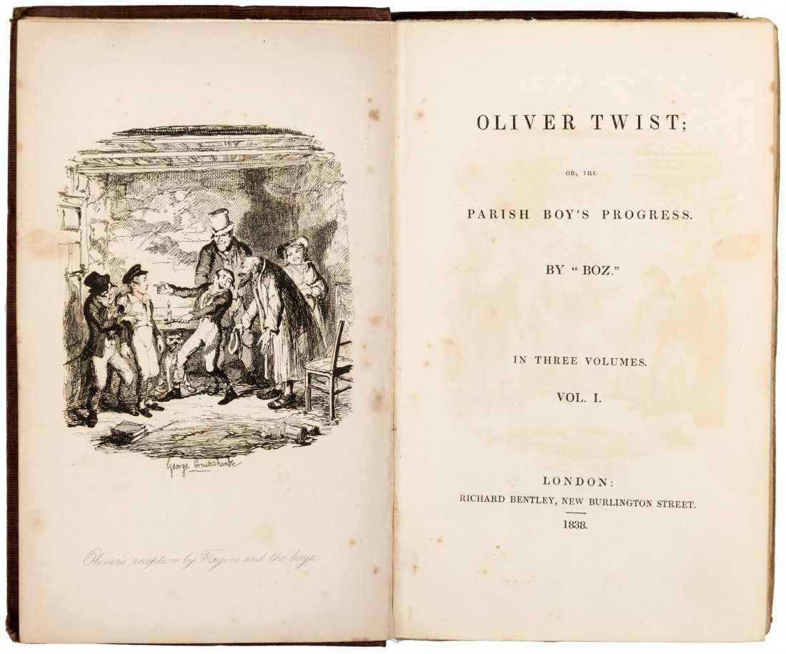
Oliver Twist
The Victorian Era ⇨ economy and workforce relied heavily on children.
Their energy, vulnerability, and inability to revolt against
injustices ⇨ easy targets for profit seeking, merciless bosses.
In Oliver Twist⇨ Oliver and the other children work most of their day in return for
⇒
very little food
crowded housing
no education

Slide 7


Kids ⇨ the only source of money for most families.
Jobs kids could uptake ⇨ the most dangerous occupations
⇩
mining
chimney sweeping
textile factories
work places
unsafe environments (polluted air)
dangerous machinery,
collapsible ceilings
rat infestations
diseases
1833: The Factory Act was passed
That was the start of many other Acts to protect the rights of children in the work force in Victorian England

