Slide 1
Human Rights and the Italian Constitution
Marco Puntin
5QLSC
A.S. 2018/2019 Lingua e cultura inglese

Slide 2
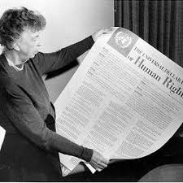
WORK CONTENTS
Human rights during history
Italian Costitution
Right of education
Right of equality
Equality of sex

Slide 3
HISTORY OF HUMAN RIGHTS
2050 b.C. : Hammurabi shares to Ur's citizens “Hammurabi Code”
539 b.C : Ciro the Great composes the “Ciro's cylinder”
1215 : John Lackland is obliged to grant the “Magna Charta Libertatum”
1848 : in Italy after a civil war period, is given off the “Albertine Statute”
1948: on the 10th December, ONU declares the “Universal Declaration of the Human Rights”

Slide 4
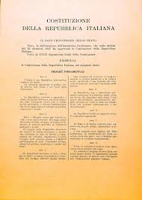
ITALIAN CONSTITUTION
The Italian Constitution is the fundamental container of italian state's laws. It was firmed by Enrico De Nicola on 27th December 1947 and became active by the 1st January 1948, 100 years later the publication of the Albertine Statute.
It's divided into:
Major principles
Rights and duties
State's organization
Final dispositions
If we compare the Italian Constitution
we can find a lot of similarities with the UHDR

Slide 5
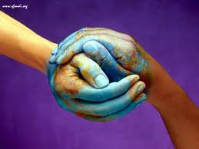
RIGHT TO EQUALITY
This kind of right is highly important because it comprehends also equality to religion, sex, and identity.
Connected to “The reluctant fundamentalist” we can know that in ever history period human beings tried to treat seriously human rights, but without success, cause to the think of the “middle class”.
Today human rights has a big importance where laws recognizes equality.

Slide 6
ARTICLE NUMBER 3 OF ITALIAN CONSTITUTION
“Tutti i cittadini hanno pari dignità sociale e sono eguali davanti alla legge, senza distinzione di sesso, di razza, di lingua, di religione, di opinioni politiche, di condizioni personali e sociali.
È compito della Repubblica rimuovere gli ostacoli di ordine economico e sociale , che, limitando di fatto la libertà e l'eguaglianza dei cittadini, impediscono il pieno sviluppo della persona umana e l'effettiva partecipazione di tutti i lavoratori all'organizzazione politica, economica e sociale del Paese.”
---------------------------------------------------------------------------------------------------
ARTICLE NUMBER 3 UDHR:
“Everyone has the right to life, liberty and security of person.”

Slide 7
RIGHT TO EDUCATION
ARTICLE NUMBER 26 OF UDHR
Everyone has the right to education. Education shall be free, at least in the elementary and fundamental stages. Elementary education shall be compulsory. Technical and professional education shall be made generally available and higher education shall be equally accessible to all on the basis of merit.
ARTICLE 34 OF ITALIAN CONSTITUTION
“L'istruzione inferiore, impartita per almeno otto anni, è obbligatoria e gratuita. I capaci e meritevoli, anche se privi di mezzi, hanno diritto di raggiungere i gradi più alti degli studi.”

Slide 8
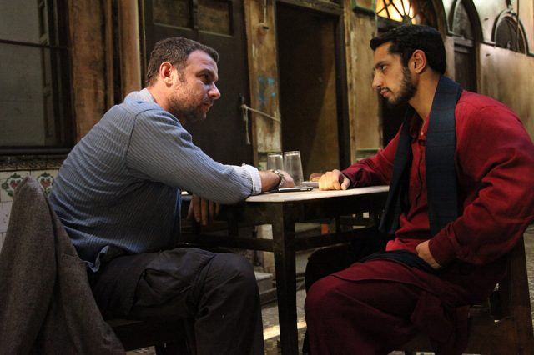
In every period of history, the right to education has always been seen as a privilage of who had enough richness, so linked to the social status.
Linked to our analyzed texts...
Changez is an example of a brilliant student who hadn't the economic base to face graduate, but he developed his graduate in Princeton.

Slide 9
EQUALITY OF SEX
ARTICLE NUMBER 51
“Tutti i cittadini dell'uno o dell'altro sesso possono accedere agli uffici pubblici e alle cariche elettive in condizioni di eguaglianza, secondo i requisiti stabiliti dalla legge. A tale fine la Repubblica promuove con appositi provvedimenti le pari opportunità tra donne e uomin.
La legge può, per l'ammissione ai pubblici uffici e alle cariche elettive, parificare ai cittadini gli italiani non appartenenti alla Repubblica.
Chi è chiamato a funzioni pubbliche elettive ha diritto di disporre del tempo necessario al loro adempimento e di conservare il suo posto di lavoro”

Slide 10
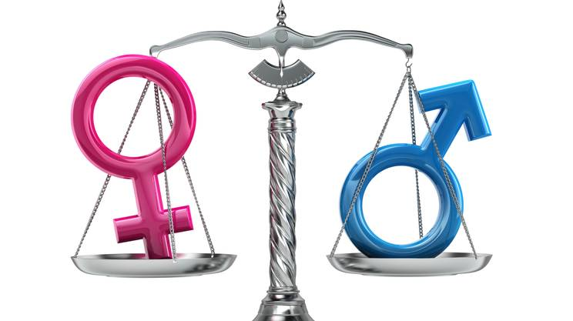
Nowadays this article is respected partially, women have always been discriminated
Linked to our analyzed texts...
Lispeth she had to became a wife of someone who had her same origins
Growing up Doris, one day, will be a mother, teacher or a nurse, no one asks to her if she wants to become the president of U.S.A. one day

