Slide 1
“Family is a right”
C. VERSOLATTO 5N LSU
Polo Liceale A. Einstein A.S. 18-19
Citizenship and Constitution
Lingua e Cultura Inglese

Slide 2
TABLE OF CONTENTS
The aim of my Power Point Presentation
Introduction to Human Rights
Historical background
Article of Italian Constitution
From literary texts and documents
Expressing a personal opinion

Slide 3
AIMS
Discuss Human Rights
Focus on the “right to marry and form a family”
Give some historical information
Identify a logical-path between Human Rights and the text analysed during the English lessons
Express a personal opinion

Slide 4
Brief introduction on human rights
IDENTIFY MEANING
Human: adjective it identifies a member of the Homo sapiens species; a man, woman or child; a person.
Rights: noun Things to which you are entitled or allowed; freedoms that are guaranteed.
Human Rights: noun The rights you have simply because you are human.
FEATURES
universal
a choice and an opportunity
finally resulted in the Universal Declaration of Human Rights

Slide 5
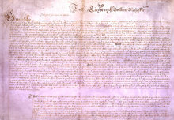
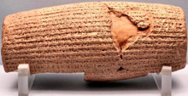
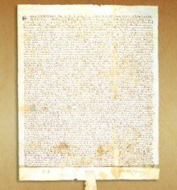
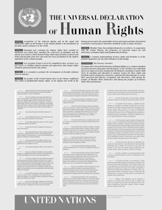
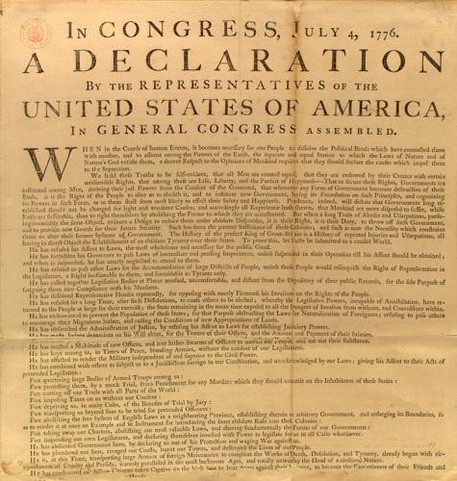
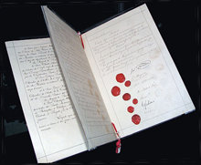
historical background
Petition of Right
The United Nations
Bill of Rights
The Cyrus Cylinder
1
(539 B.C.)
(1628)
(1791)
(1945)
(1215)
(1776)
(1864)
The Universal Declaration of Human Rights (1948)
The Magna Carta
The First Geneva Convention
United States Declaration of Independence

Slide 6
Article 9 –Right to marry and right to found a family
The right to marry and the right to found a family shall be guaranteed in accordance with the national laws governing the exercise of these rights.
Constitution of the Italian Republic
Art. 29. The Republic recognises the rights of the family as a natural society founded on marriage. Marriage is based on the moral and legal equality of the spouses within the limits laid down by law to guarantee the unity of the family.

Slide 7
from Edith Wharton’s Ethan Frome
All constraint had vanished between the two, and they began to talk easily and simply. They spoke of every-day things, of the prospect of snow, of the next church sociable, of the loves and quarrels of Starkfield. The commonplace nature of what they said produced in Ethan an illusion of long-established intimacy which no outburst of emotion could have given, and he set his imagination adrift on the fiction that they had always spent their evenings thus and would always go on doing so...
“This is the night we were to have gone coasting, Matt,” he said at length, with the rich sense, as he spoke, that they could go on any other night they chose, since they had all time before them.
She smiled back at him. “I guess you forgot!”
“No, I didn't forget; but it's as dark as Egypt outdoors. We might go to-morrow if there's a moon.”
She laughed with pleasure, her head tilted back, the lamplight sparkling on her lips and teeth. “That would be lovely, Ethan!”

Slide 8
from MONICA ALI’s BRICK LANE

Slide 9
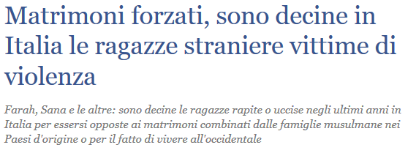
NOWADAYS…

Slide 10
RESOURCES
www.marilenabeltramini.it
Marina Spiazzi, Marina Tavella, Margaret LaytonPerformer. Culture & literature Vol 1/2
https://www.childline.org.uk/get-involved/real-life-stories/forced-marriage-dinas-story/
http://www.ilgiornale.it/news/cronache/matrimoni-forzati-sono-decine-italia-ragazze-straniere-1577574.html
https://www.humanrights.com/course/lesson/background-of-human-rights/the-background-of-human-rights.html
http://www.gliscritti.it/blog/entry/2619

