Slide 1
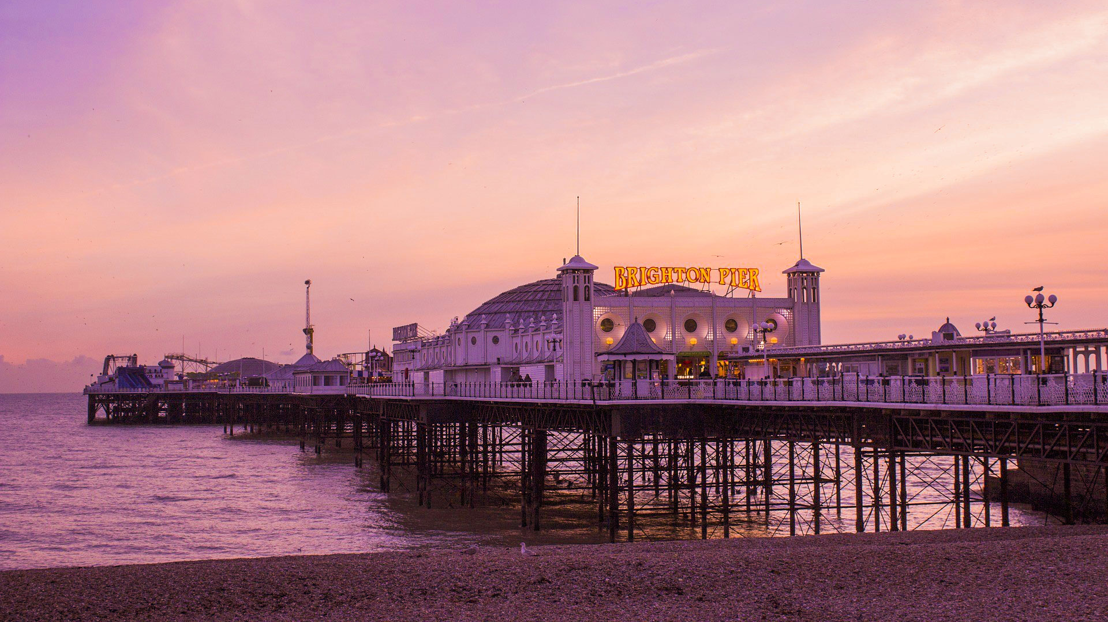
BRIGHTON
GROUP 4: Budai Isabella, Delcuratolo Sebastiano, Vicenzin Anna

Slide 2
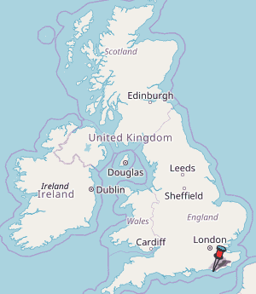
LOCATION AND SPOKEN LANGUAGES
Brighton is a small city located on the southern coast of England, in the country of East Sussex, and that is positioned only 47 miles south of London.
English is the most spoken language in this city, but studies show that there is also a small percentage of people speaking Mandarin, Greek, Italian and Russian.

Slide 3
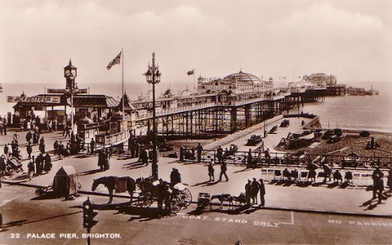
HISTORY
Brighton was born as a small village, where fishermen and farmers lived together during the Middle Age. So, at first it was a trading town, but in the XVIII century there has been a decline of the fishing branch, so a lot of people left the city to find a new job.
People started to come here again when George IV built a pavilion, that attracted the richer citizens.
A railway, connecting London to Brighton, and a dock, used for exchanges with France, were built and, as time goes on, it became a seaside resort.

Slide 4
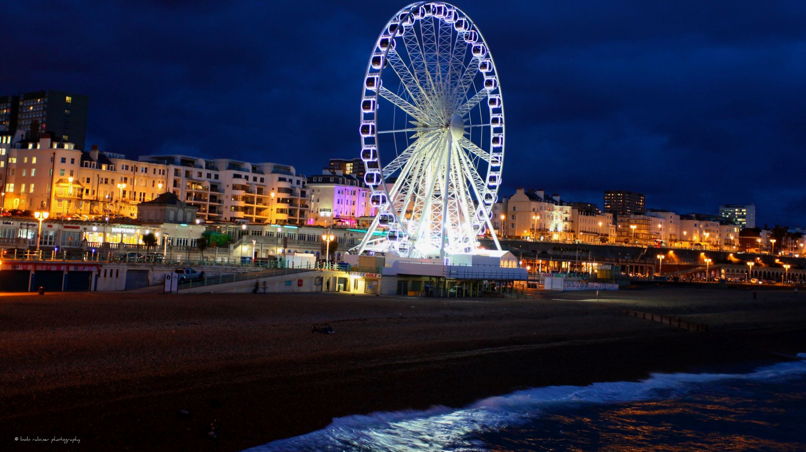
ATTRACTIONS
If you go to Broadstair you can't miss the Royal Pavilion, a magnificent Indian-style building which was originally a royal palace. Brighton pier, with its fairground attractions and amusement arcades, is the place for fun and excitement. And if you want a panoramic view of the coastline and the city, take a trip on the Brighton Wheel, as it rotates up to 50 meters above the sea level.
The Lanes is a great shopping area, where you can find jewellery and fashion.
Finally, Brighton beach is an ideal place for water sports: you can swim, sail, go kayaking or windsurfing, and even scuba diving.
All through the year there are events from water sports competitions and parties on the beach to motor rallies, and "Burning the Clocks", a spectacular lantern parade with fireworks for the Winter Solstice.

Slide 5
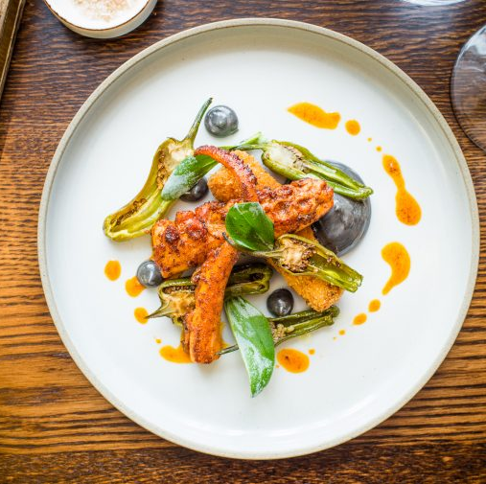
SUGGESTIONS FOR EATING
Brighton is famous for its high numbers of restaurants, pubs, cafes and bakeries; all of which offer visitors a place to enjoy a great meal by the sea.
If you visit the city, you must go to The Set Restaurant and you won’t be disappointed by the roast Sussex beef rib-eye served with dripping roasters, crisp Yorkshire pudding and vegetables.
Being Brighton a seaside town, if you go there, you can't miss seafood restaurant, like Urchin or The Little Fish Market, where you can try the traditional fish and chips, or dishes based on salmon and eels.

Slide 6
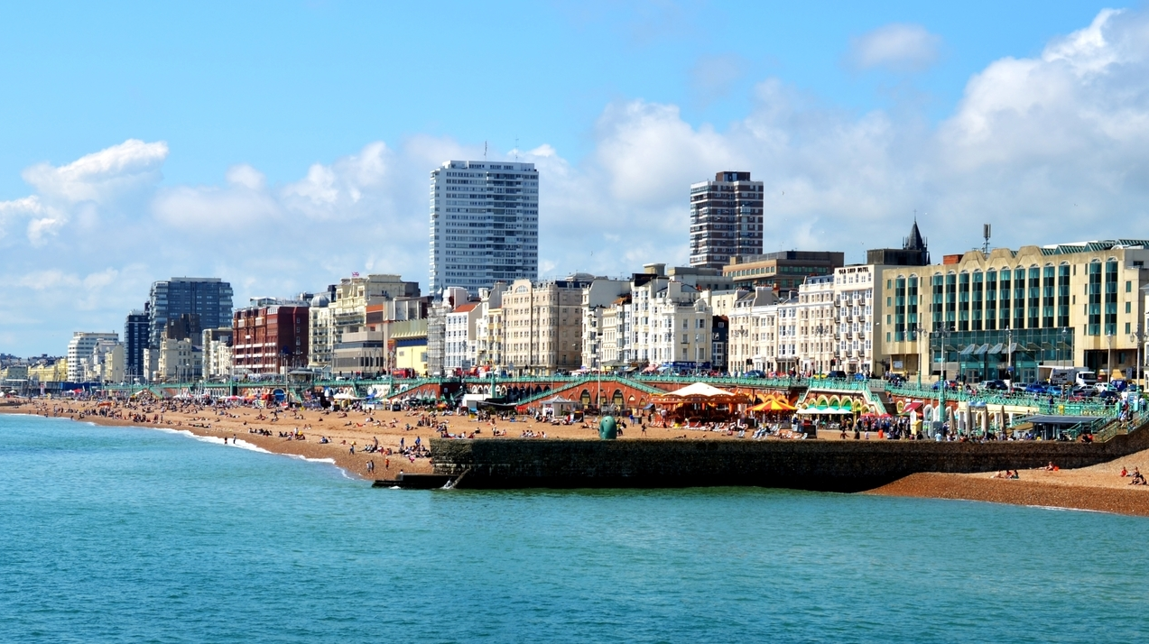
PERSONAL EXPERIENCES
I have been there with my parents when I was around 4 years old, so I don't remember much of that trip, but I do remember spending the whole day visiting the city and all of its shops and shopping centres. In the evening we had dinner in a fancy restaurant on the seaside and we took a trip on the Brighton Wheel. It was awesome! You could see the whole city from up there: it was very high up!

